Slide 1
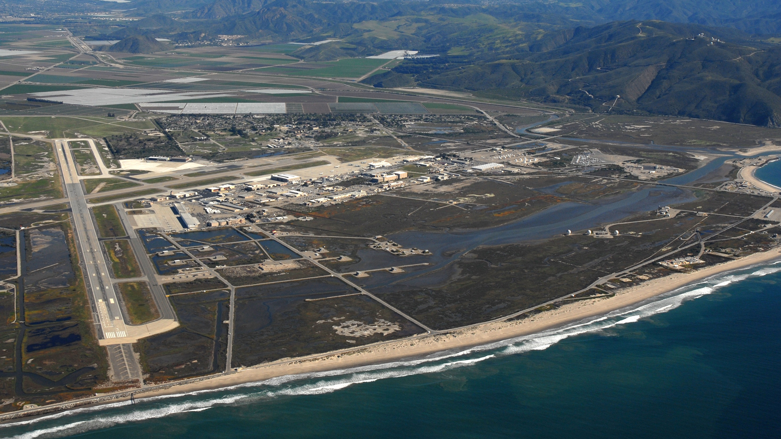
Coastal Brackish Groundwater Extraction and Treatment Project
Notes:
Section 4

Slide 2
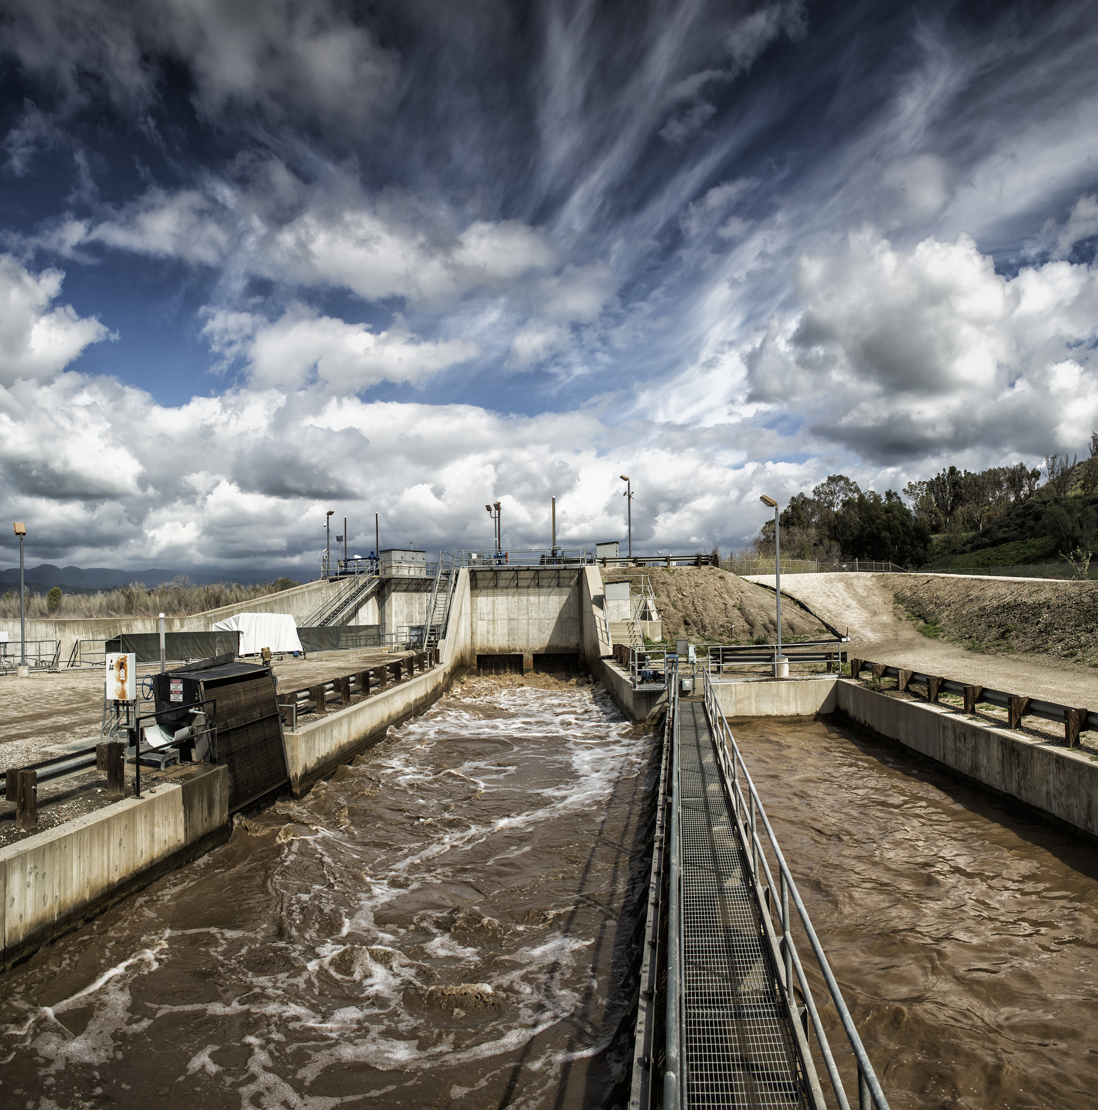
Background
Traditional approach to managing seawater intrusion:
Fill basin from the top with enhanced recharge activities
Direct use of surface water and recycled water to the extent practical
Limit pumping to bring basin into balance
Despite these good efforts, saline intrusion remains a significant problem for long term basin sustainability
Notes:
Background/Successes

Slide 3
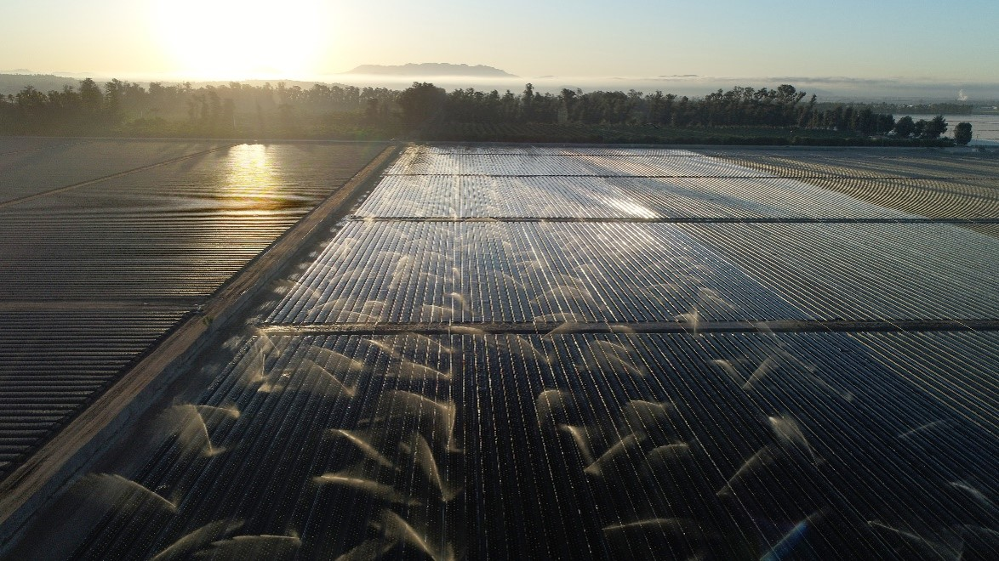
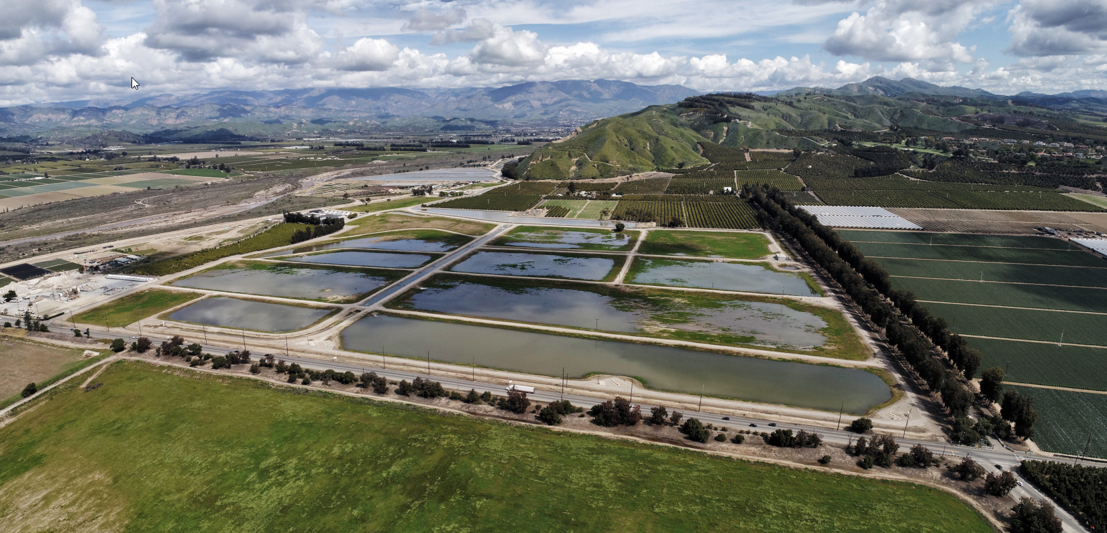
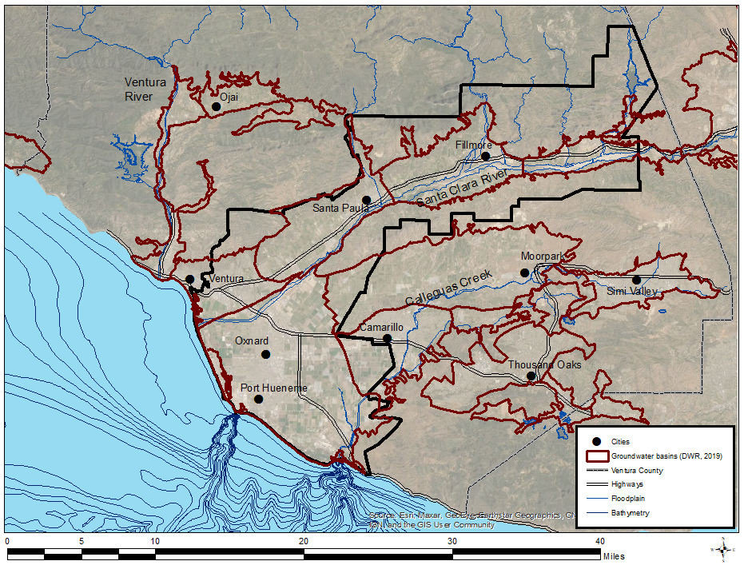
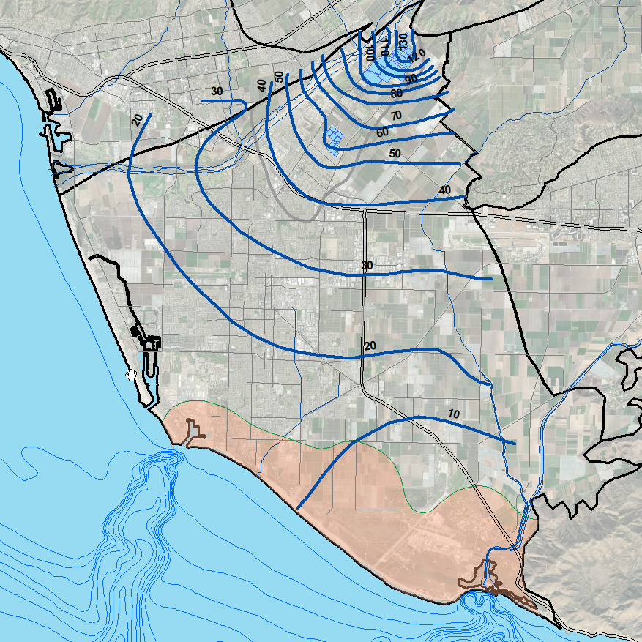
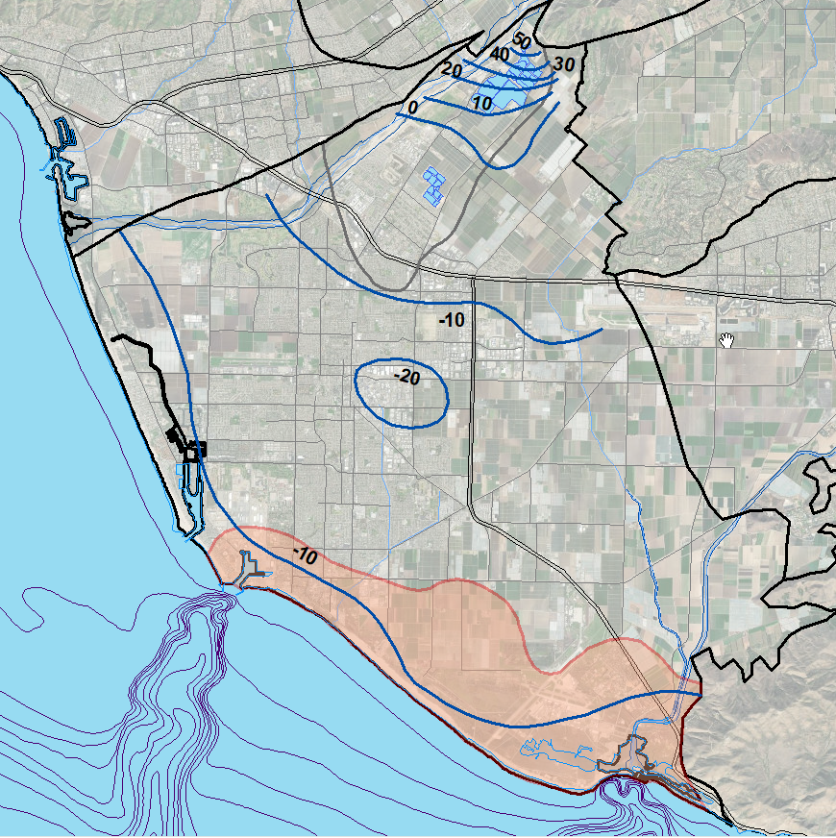
Spring 2011
Fall 2020
Notes:
District and facilities intro slide, recharge basins full, distribution facilities

Slide 4
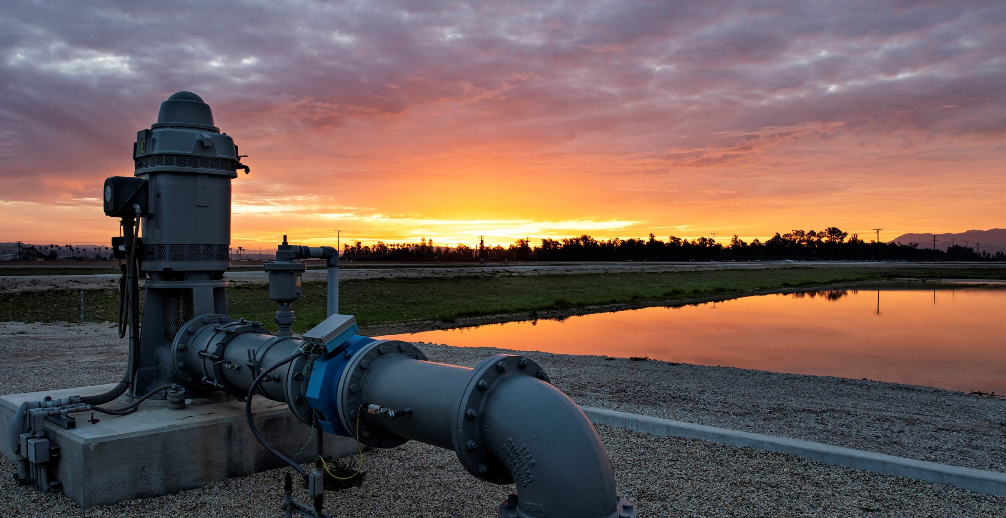
Injection vs. Extraction Barrier
LA
Large inland extent of intrusion and lack of feed water supply make injection barrier impractical in the Oxnard basin
Treated wastewater being used for direct delivery to Ag users, or for planned injection and recovery programs
Extraction barrier advantages:
Requires fewer wells to control seawater front
Seawater and brackish now source of water to be desalted
No open-water intakes that are difficult to permit
Promotes seaward groundwater gradient in the basin
Removes salt from the groundwater basin

Slide 5
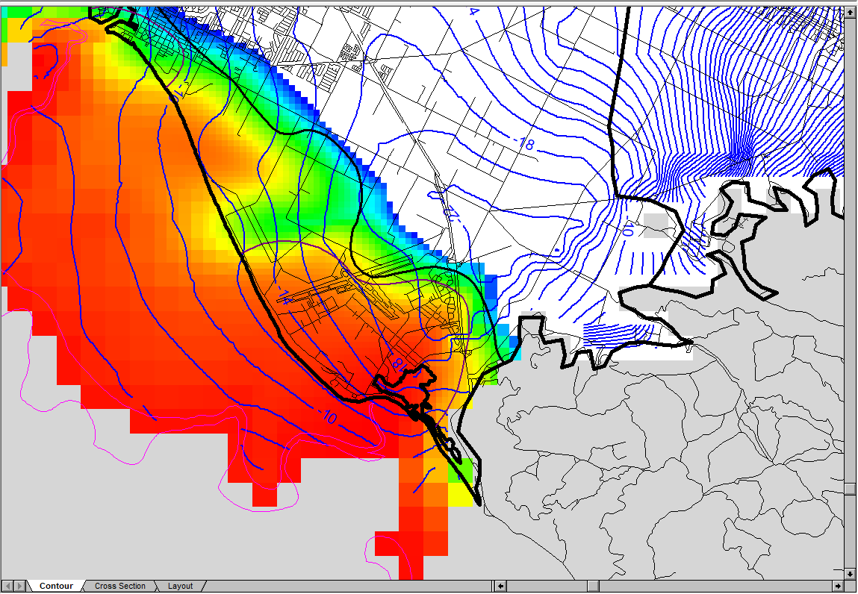
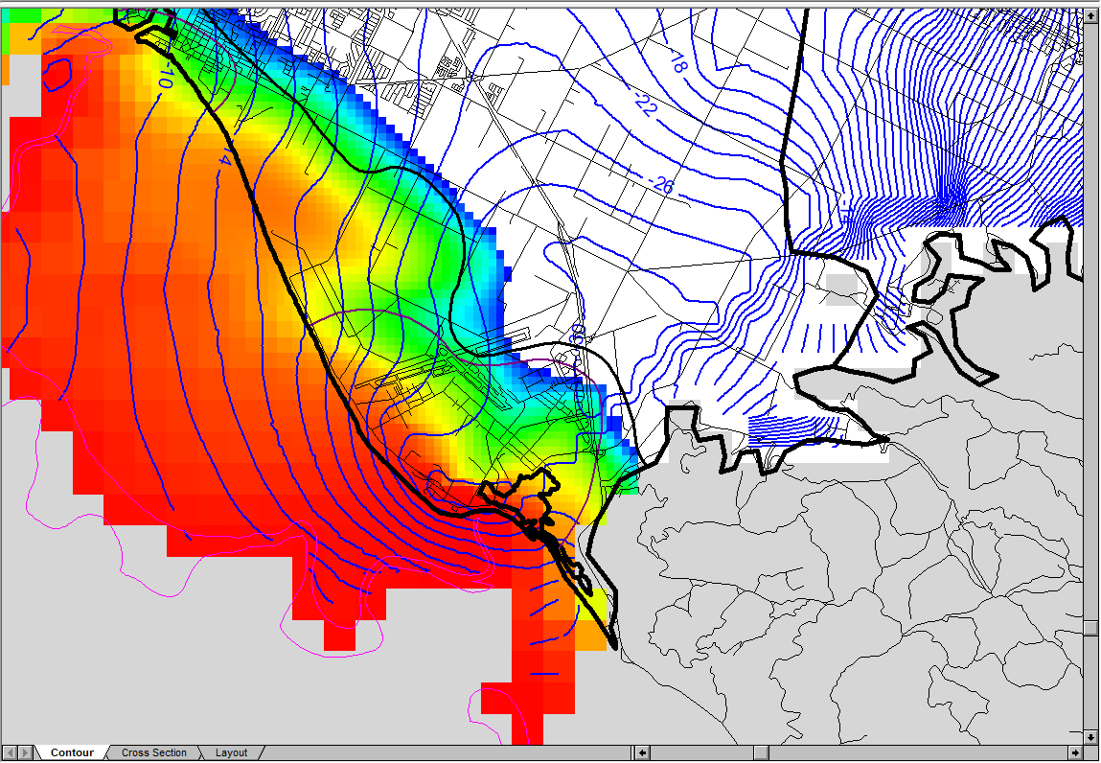
Preliminary modeling results, chloride concentrations and water levels, 10,000 AFY pumping
Water table depression will surround new coastal wells, not inland production wells
Modest water level decline in nearby wells
Base Case – recent pumping rates
With Coastal Extraction Wells
Driest month in GSP’s 50-year simulation period (1930-1979)

Slide 6
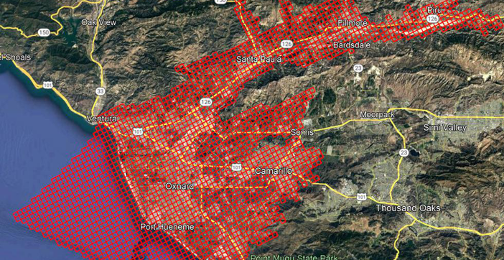
Groundwater Flow Model
Regional Model was developed by United staff to assess management actions and water supply alternatives District-wide, including changing climate.
Coastal Plain Model recently upgraded to include solute transport.
Model upgrade supported by Prop 1 Planning Grant (Thanks Water Boards!)
Planning Grant work includes revised geologic model in the project area
6

Slide 7
Section N Detail, Design Project Flow Pattern
Model pumping rates from the confined Oxnard and Mugu aquifers that control seawater intrusion but avoids significant vertical flow down from the unconfined Semi-perched aquifer
Oxnard
Mugu
Fox Canyon
Legend:
Seawater
Brackish
Perched Water
Fresh Water

Slide 8
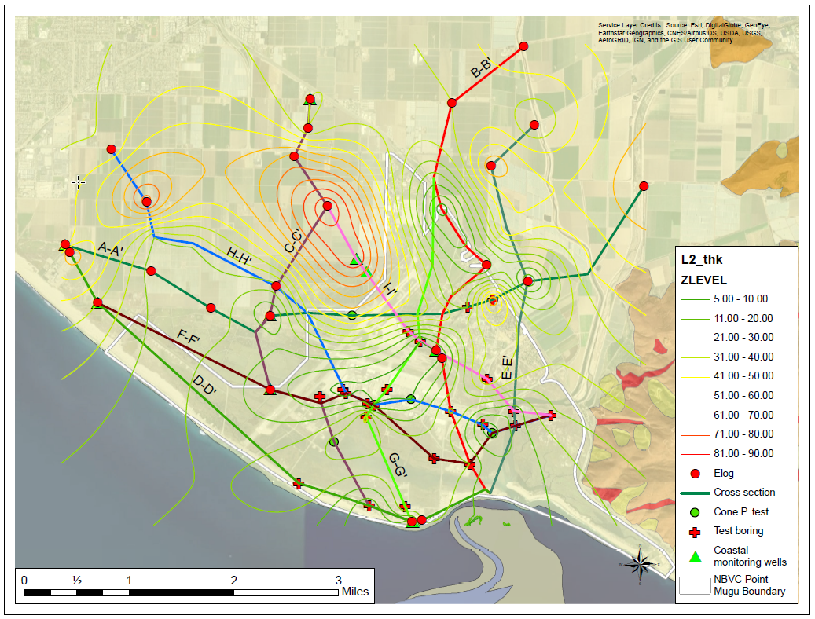
Need to assess potential for leak down at higher pumping rates
Considering use of geophysics to further map confinement, zones of water movement
Notes:
Thin confining unit a concern, complicated setting, near-surface contaminants

Slide 9
Now need to model various project scenarios
Use revised and recalibrated model to simulate various pumping volumes and well locations
Minimum project size about 5,000 AFY pumping
Maximum scale of project not yet determined, at least 10,000 AFY appears feasible, many variables to consider
Phase 1 pumping program is proposed, (recently applied for Prop 1 Round 3 implementation grant)
Coordinating project development with Oxnard basin GSA (Fox Canyon Groundwater Management Agency), CA state regulators and the Navy

Slide 10
Preliminary simulation of Oxnard aquifer chloride concentrations, Base Case and 10,000 AFY project
Base Case – recent pumping rates
With 5,000 AFY from Oxnard wells, 5,000 AFY from Mugu
50-year simulation period (1930-1979 hydrology)

Slide 11
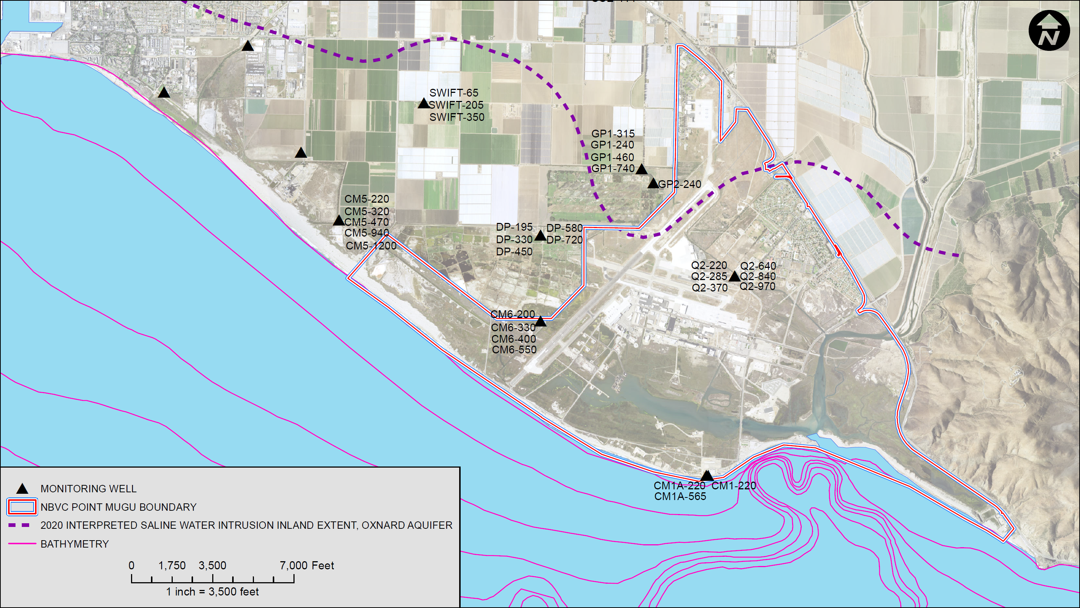
Expanded Baseline Groundwater Water Quality Sampling June 2020 to present
Treatment Performance
NPDES Discharge
Groundwater Conditions

Slide 12
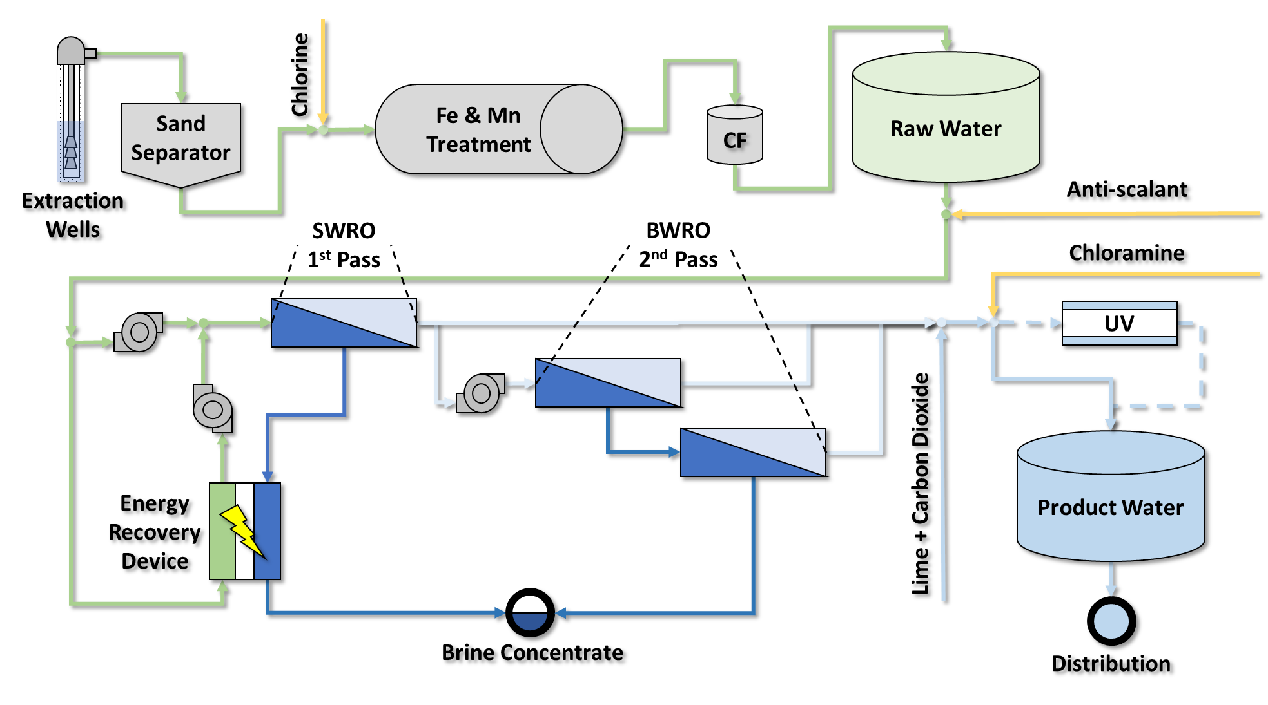
Conceptual Treatment
Notes:
Well Field Extraction (min 10,000 AFY and more TBD
RO Efficiency 50-70 %
Brine Disposal and Brine Management –Calleguas SMP
Energy Optimization (ERS to be evaluated)

Slide 13
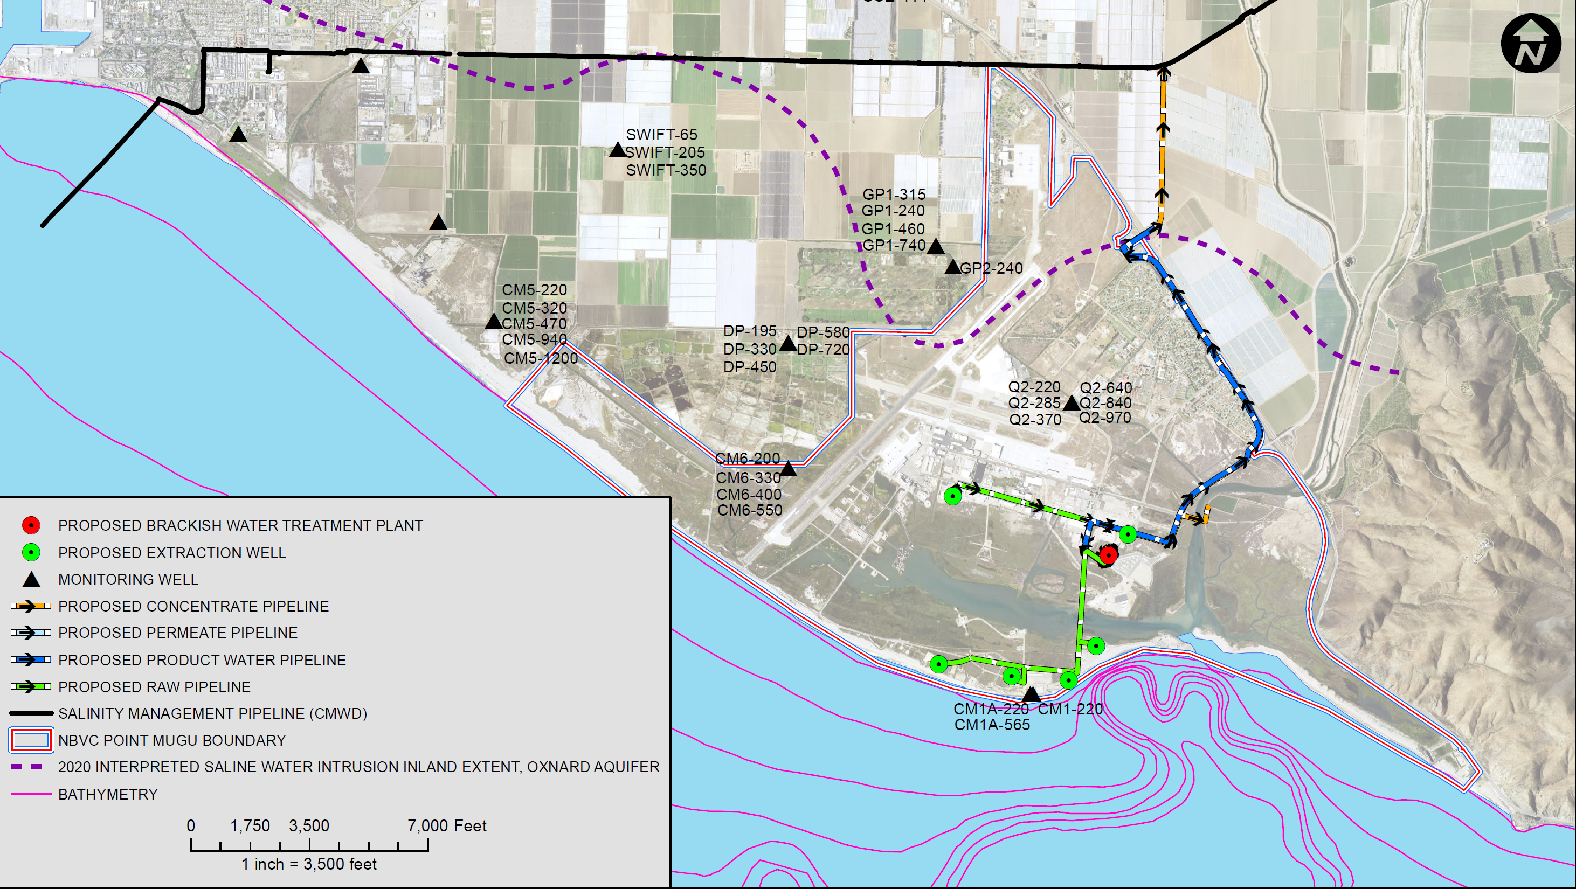
Drinking Water Delivery to NBVC Point Mugu
Delivery of High-Quality Water to Beneficial Use Outside of the Base
Brine Concentrate Pipeline

Slide 14
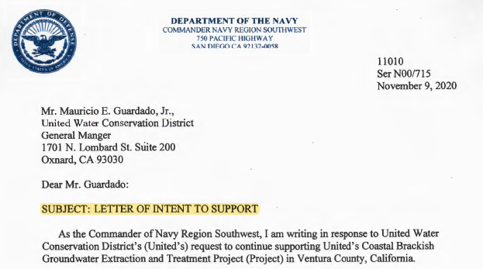
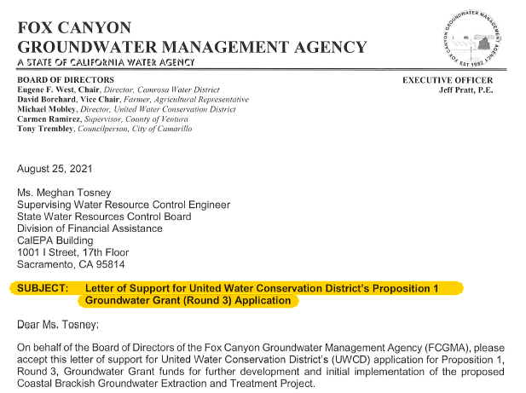
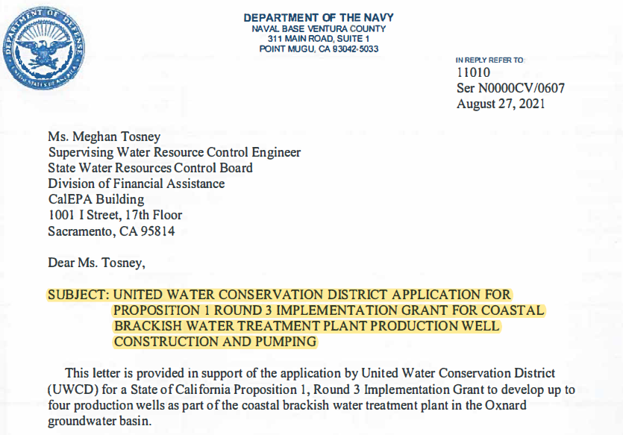
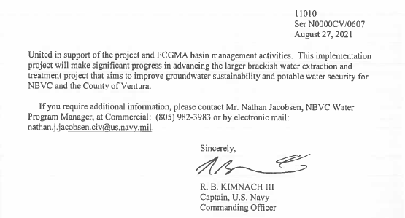
Project Support

Slide 15
Project Activities
2020
Water Sustainability Summit #1
Started Quarterly Groundwater Sampling
Letter of support from the Commander of Navy Region Southwest
Extraction Well Field Siting
Navy Leadership and United Progress Update Meeting
2021
NAVFAC EXWC's Seawater Desalination Test Facility Visit
Consultant Interviews for CEQA Initial Studies
Water Treatment Modeling
Distribution Alternatives Assessment
Navy Leadership and United Progress Update Meeting
2022
Navy Leadership and United Progress Update Meeting
MOU between NBVC and United
Prepare for Bench Scale/Pilot Testing Plan
Notes:
Complete groundwater flow model scenarios
Complete groundwater quality baseline
Prepare pilot testing plan
Advance treatment plant modeling

Slide 16
Project Benefits
Sustainable solution to combat seawater intrusion problem
Long-term protection of groundwater basins
Groundwater quality improvement in the coastal zones
Reliable local supply, and a drought proof project
Help diversify regional water supply portfolio
Alternative superior quality water supply
Significant contribution to sustainable yield of Oxnard and Pleasant Valley Basins
Potential for yield increase

Slide 17
U.S. Navy’s Role and Project Support
Positive Prop 1 Efforts
Local agencies and TAC project support
Navy leadership provided UWCD a letter of support for DWR Prop 1 Round 3 grant program
Project feasibility can enable a long-term real estate agreement
Navy is supporting implementation efforts
Working with UWCD to assess if bench scale testing of different treatment technologies can be done at local Navy facilities
Prop 1 Round 3 Project Concept includes on-site wells aquifer testing
On-going pre-engineering and permitting support

Slide 18
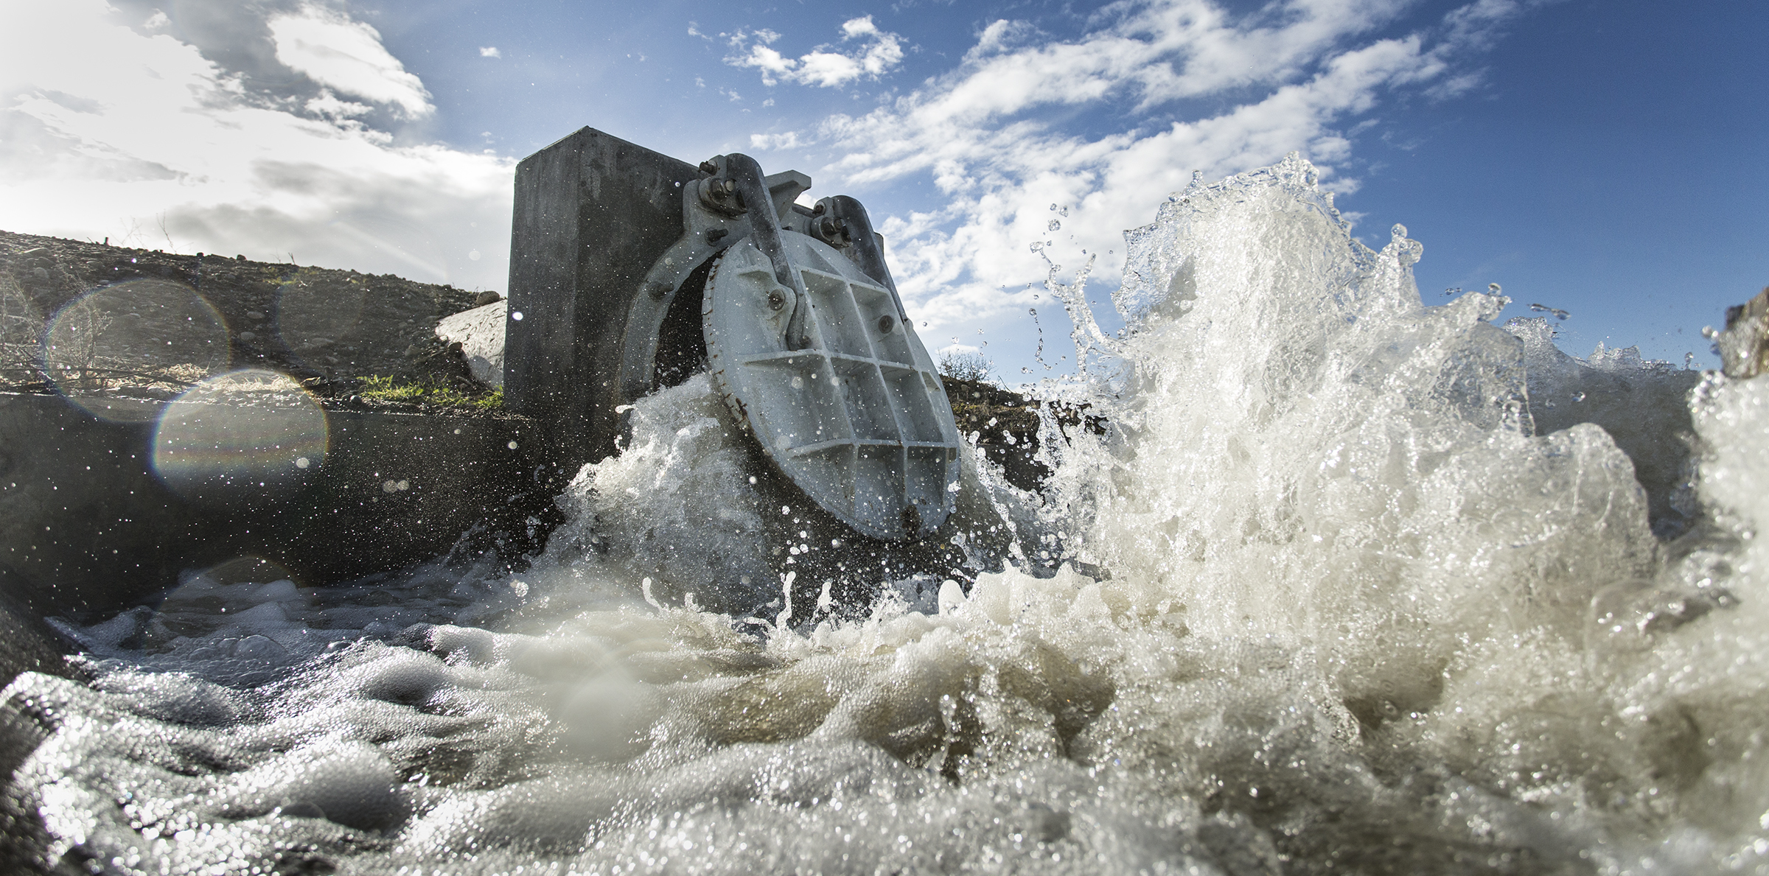
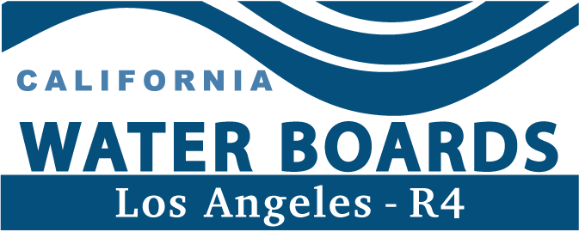
Partners
PHWA
PORT HUENEME
WATER AGENCY
Notes:
2 - Players

