Slide 1
OPTIMIZING OUR STATE WATER PROJECT ALLOCATION
Taking advantage of additional opportunities to secure imported water
Brian Collins, Chief Operations Officer
Ph:805-525-4431
BrianC@unitedwater.org

Slide 2
Table A Transfers & additional Article 21 rights
Casitas Municipal Water District and United’s Board of Directors have approved the purchase terms of CMWD Table A water for up to the next 5 years.
This could mean as much as 5,000 AF of additional water for the region in any given year depending on the State Water Availability.

Slide 3
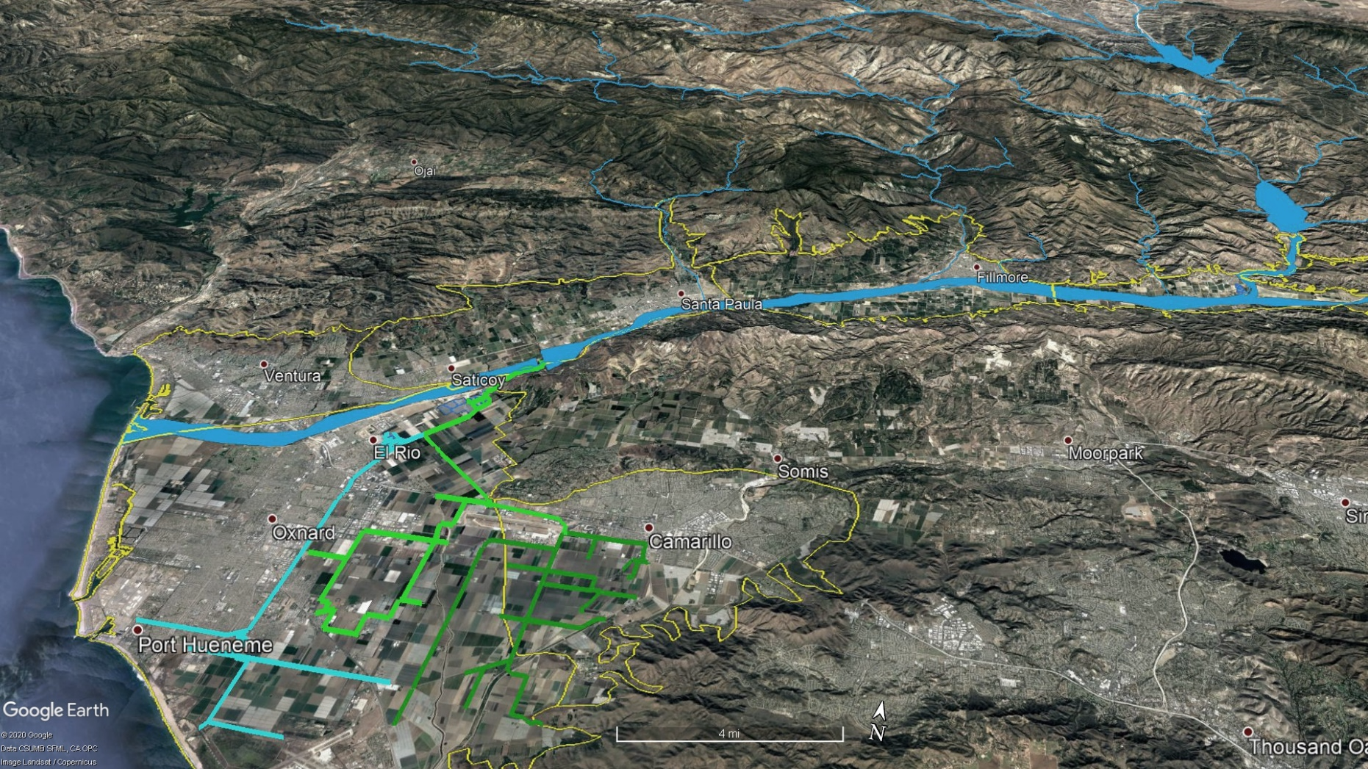
State Water Benefits
Pyramid Lake
Lake Piru
Freeman Diversion
Spreading grounds
O-H/Oceanview pipeline
PTP/PV
delivery system

Slide 4
State Water Project Purchases, Exchanges & Transfers
Cumulative 44,385 AF
2016-2022
8,150

Slide 5
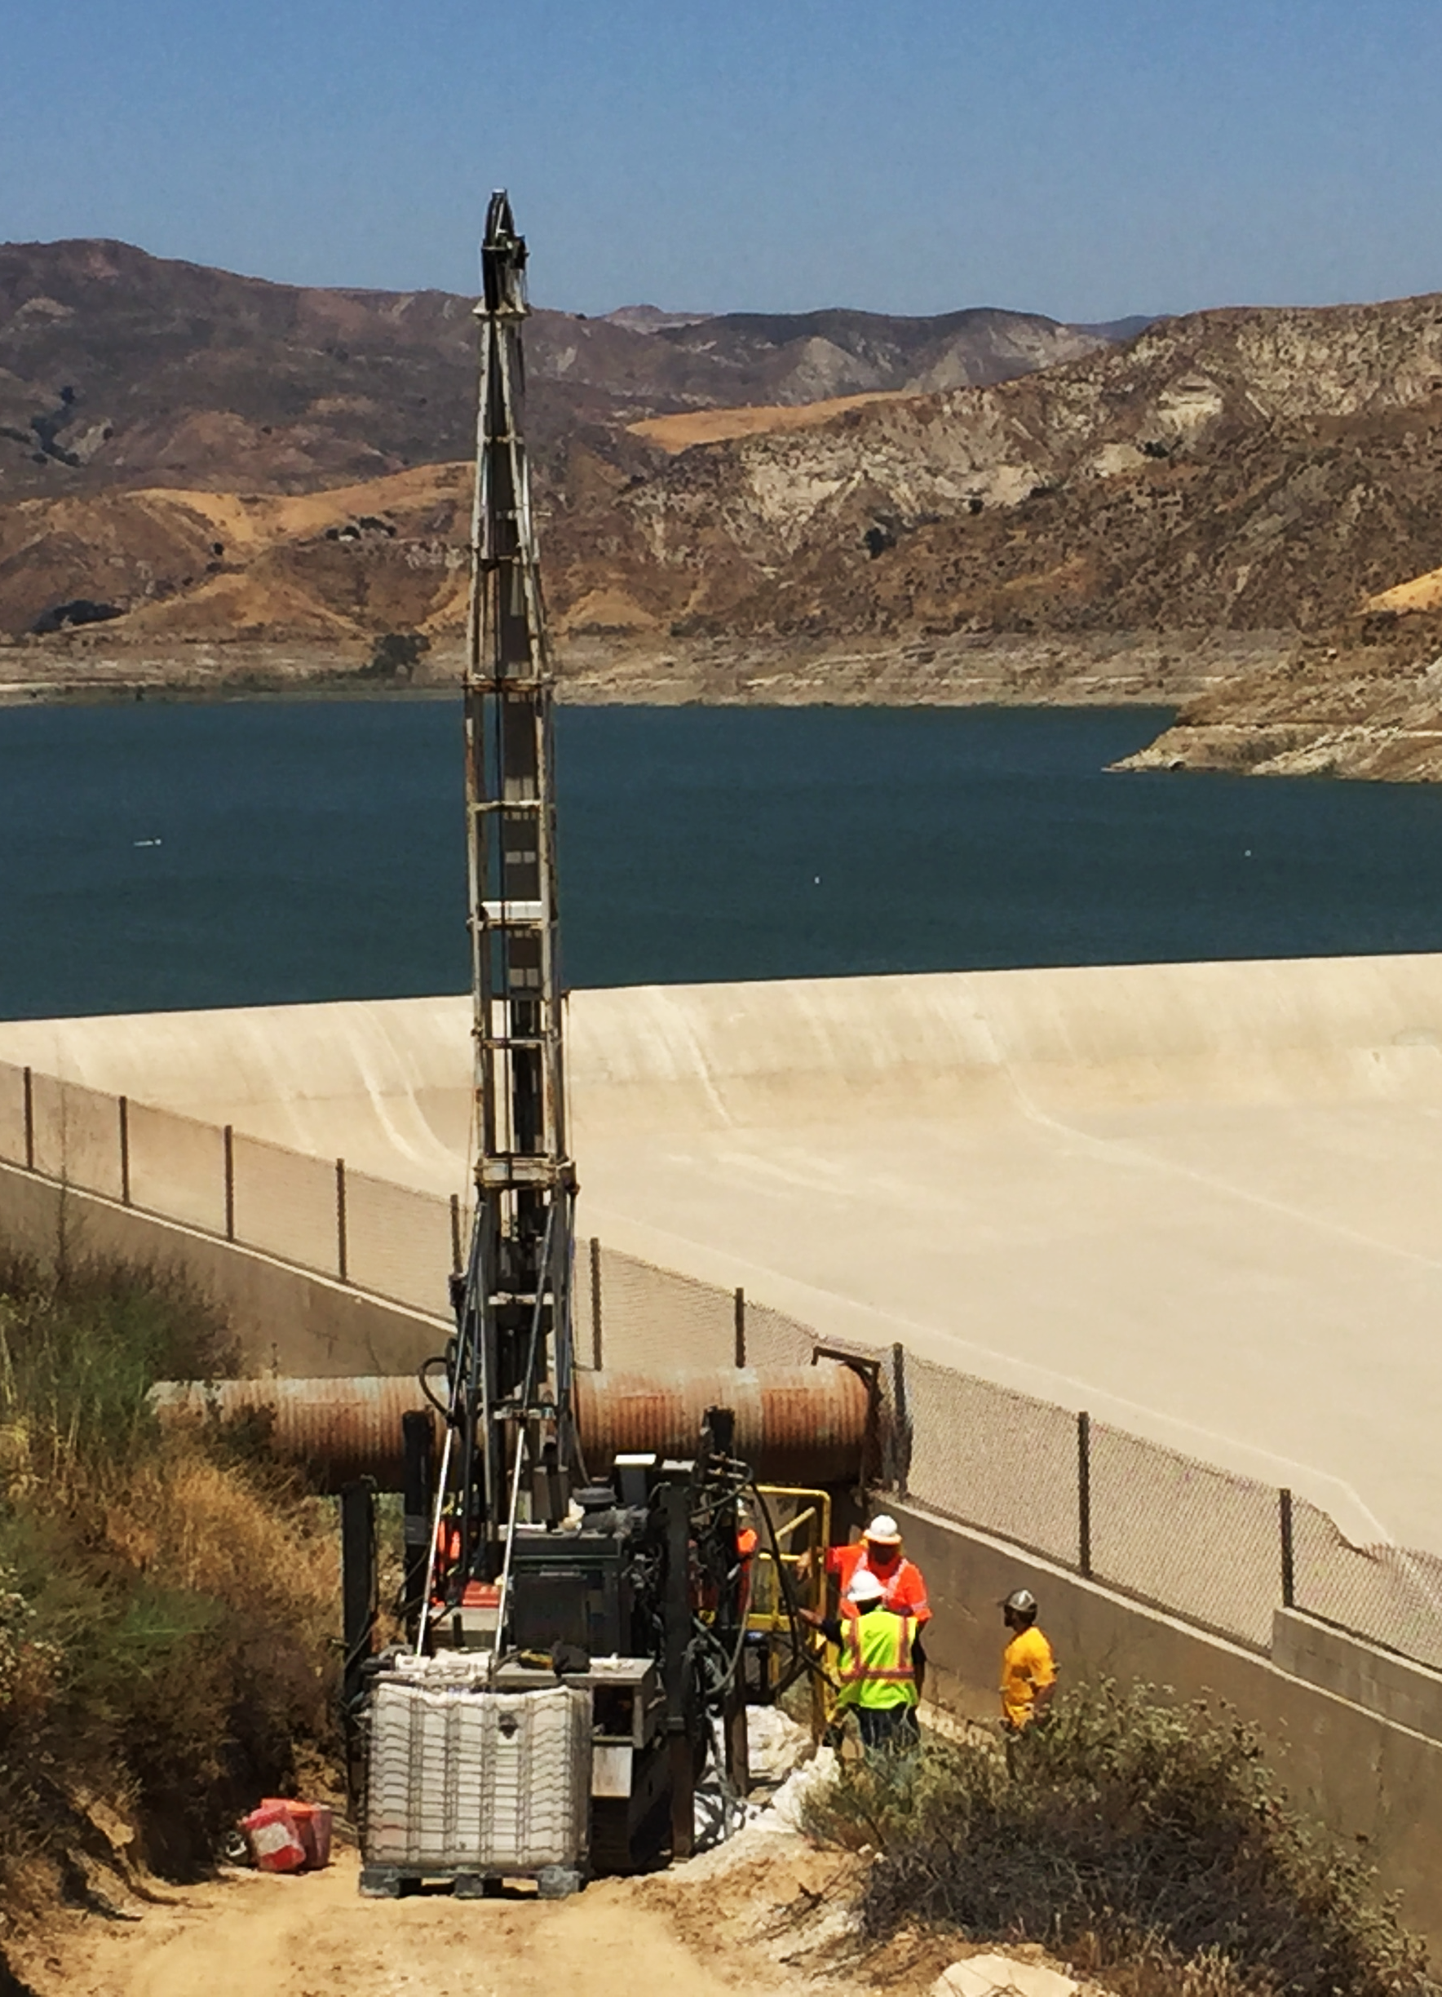
Additional Project Benefits
2020 Release from Santa Felicia Dam - 31,795 Acre-Feet
Direct benefit to 337,000 regional residents
1,592,115 kWH of energy savings; 190 kW peak demand savings
Reduction of over 350 metric tons of CO2 equivalent greenhouse gases (GHG), comparable to removing 75 cars off the road annually
Consistent with the Governor’s August 2022 California’s Water Supply Strategy – Adapting to a Hotter, Drier Future

