Slide 1
FREEMAN CONVEYANCE SYSTEM UPGRADE
(Phase 1)
Maryam Bral, PhD, PE, Chief Engineer
Ph: 805 525 4431
maryamb@unitedwater.org

Slide 2
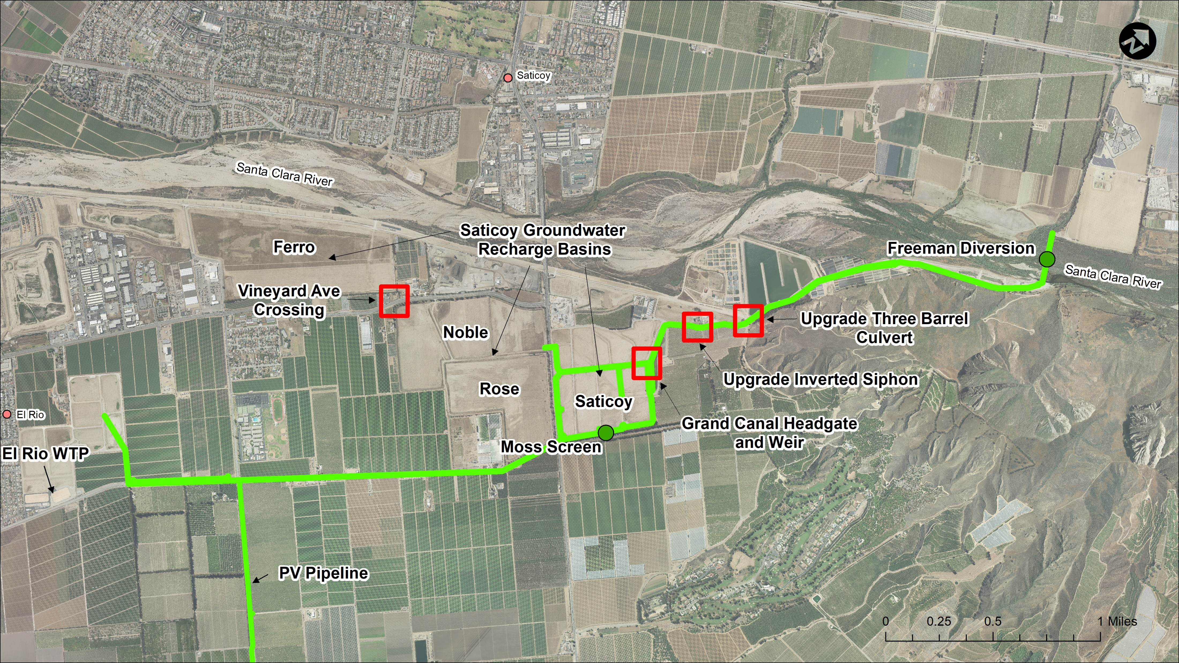
Notes:
The four red squares represent the 4 projects that will reduce the conveyance system bottlenecks and provide surface water to the Ferro Basin.

Slide 3
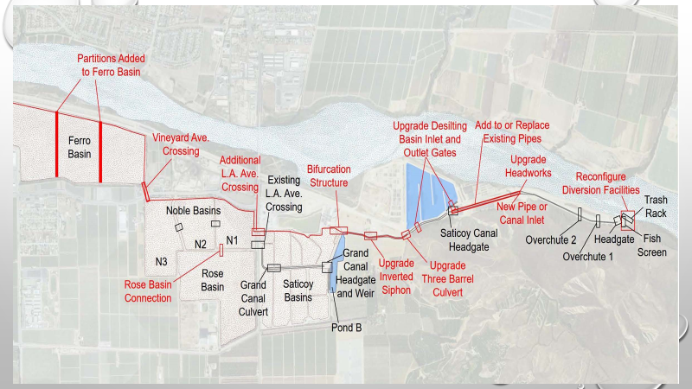
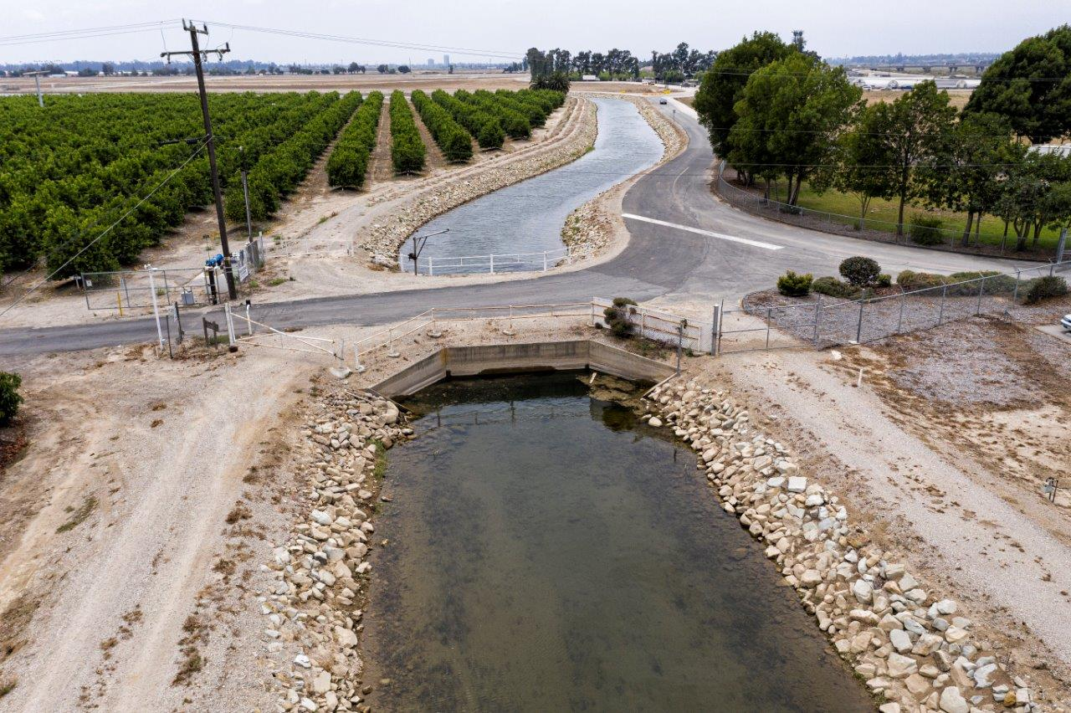
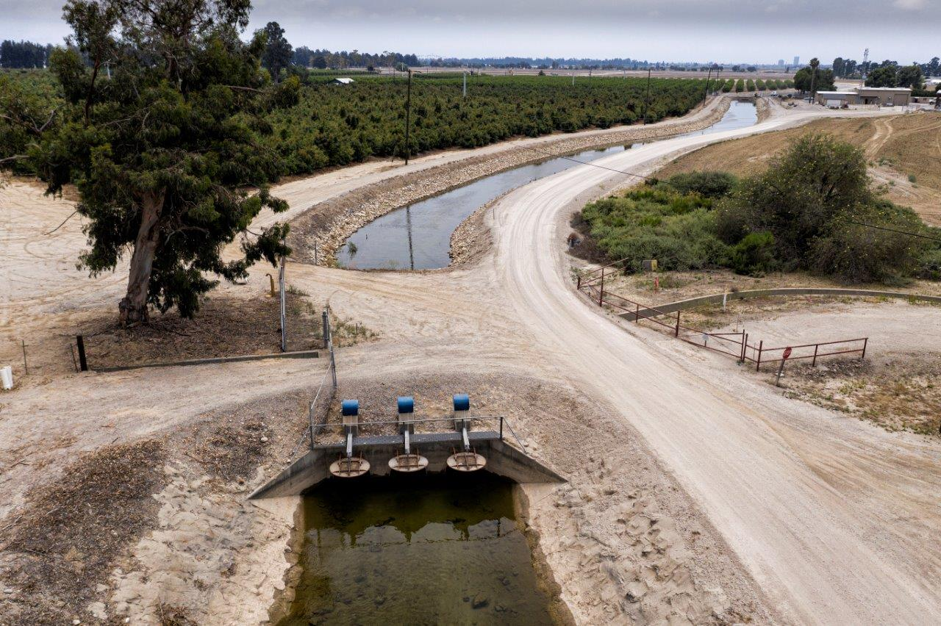
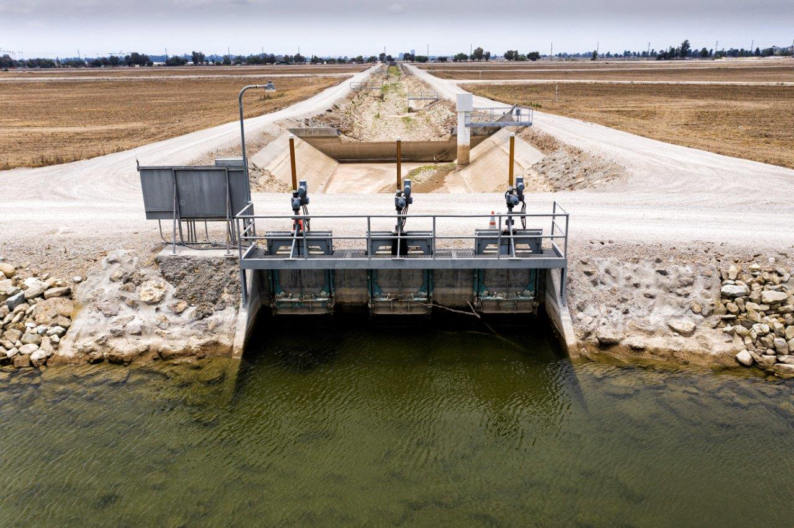
Notes:
Pictures show the three-barrel culvert, inverted siphon and gran canal headworks. The background photo shows the conveyance system upgrades that will allow UWCD to convey up to 750 cfs to the Ferro Basin. The upgrades will be constructed in a phased approach. The first phase will focus on removing the bottlenecks experienced at United’s existing diversion rate (375cfs).

Slide 4
Phase 1 of the Freeman Expansion Project –
Grand Canal Project
Notes:
The first project in Phase 1 was the replacement of the Grand Canal Headworks, which was completed in 2021. This project increased the entrance capacity of the canal entrance to 500 cfs. The following slides show the construction of this project.

Slide 5
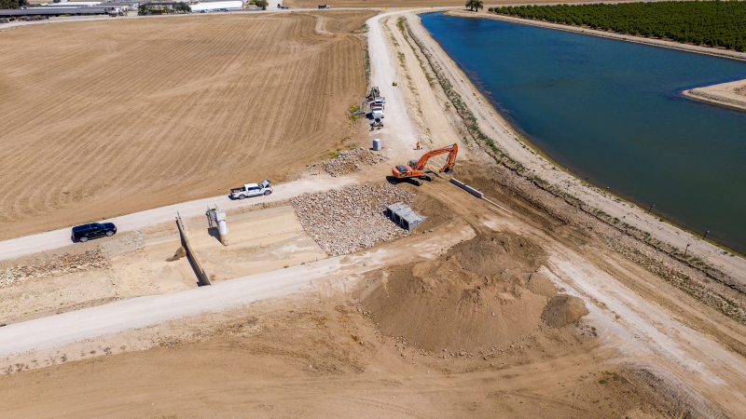
Grand Canal Project (continued)
Notes:
The first project in Phase 1 was the replacement of the Grand Canal Headworks, which was completed in 2021. This project increased the entrance capacity of the canal entrance to 500 cfs. The following slides show the construction of this project.

Slide 6
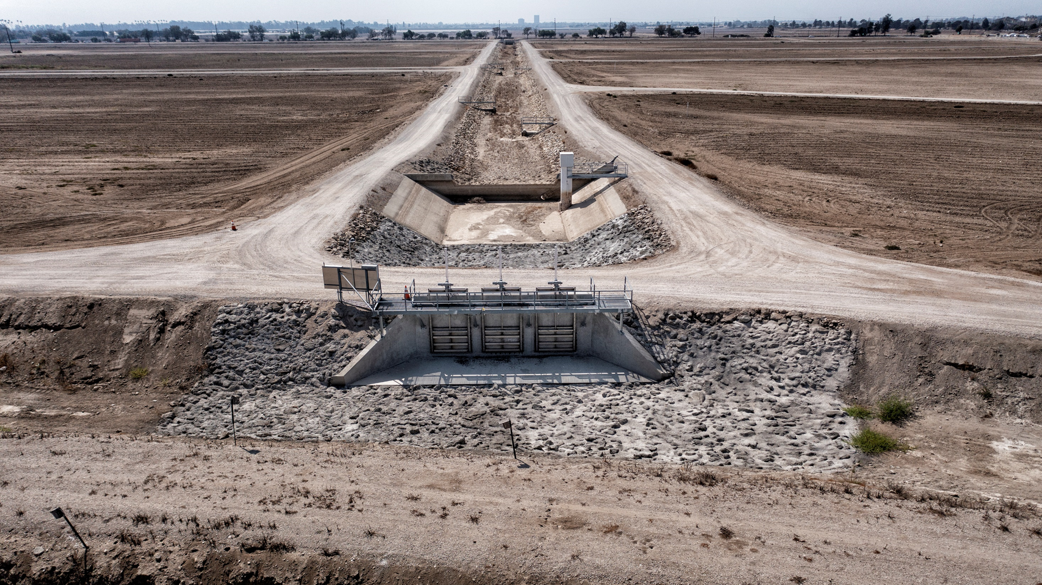
Grand Canal Project (continued)
Notes:
The first project in Phase 1 was the replacement of the Grand Canal Headworks, which was completed in 2021. This project increased the entrance capacity of the canal entrance to 500 cfs. The following slides show the construction of this project.

Slide 7
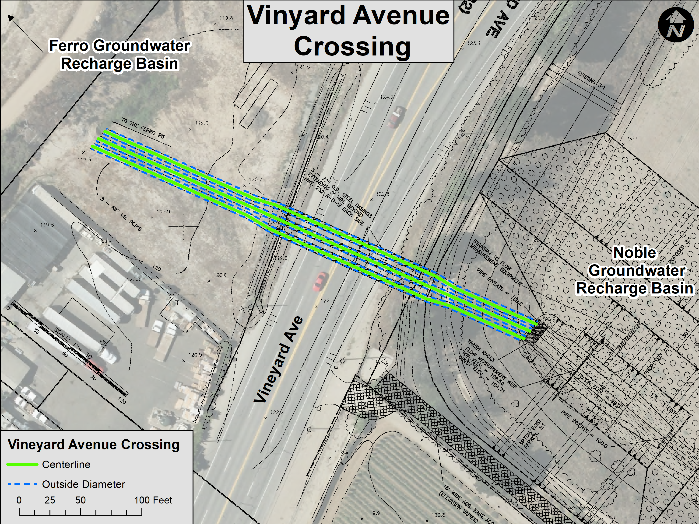
Groundwater Recharge Capacity Expansion Project
Vineyard Avenue Crossing
Vineyard Avenue Crossing

Slide 8
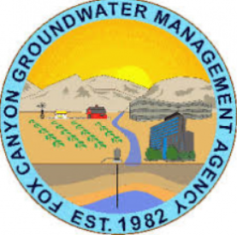
Project Costs: $4,500,000
Grant Funding:
Sustainable Groundwater Management (SGM) Grant Program
$2,510,300 (no local match required)
Potential Funding
Integrated Regional Water Management Grant Program (IRWMP) - Round 2 – Implementation
$1,000,000 – requiring a 50/50 local match (Groundwater Recharge Capacity Expansion)
Notes:
United received grant funding for the Vineyard Avenue Crossing.

Slide 9
Project Component Timelines
Today
 | 2021 | 2022 | 2023 | 2024 | 2025 | 2025 | 2026 | 2027
Grand Canal | √ Completed
Inverted Siphon* |  | Design | Construction
Three Barrel Culvert* |  | Design | Permitting | Construction
Vineyard Ave Crossing** (Recharge Capacity Expansion) | Planning |  |  |  | Design |  | Construction
*SGM Grant Completion Date by April 2025
**IRWMP Grant Funding Completion Date January 2027
Notes:
Phase 1 timeline

