Slide 1


EXTRACTION BARRIER
AND BRACKISH (EBB)
Water Treatment Project
  Maryam Bral, PhD, PE, Chief Engineer
  maryamb@unitedwater.org
  Dan Detmer,
  Water Resources Manager dand@unitedwater.org

Slide 2
LARGE GROUNDWATER BASINS in southern Ventura County (all are DWR high-priority basins)
EXTENSIVE RELIANCE on groundwater for both Ag and M&I supply
LONG HISTORY of overdraft and seawater intrusion in coastal basins
Long history of conjunctive use strategies
Managed aquifer recharge
Use surface water and imported water when available
Use of groundwater when it is not.
Demand management by FCGMA

Slide 3
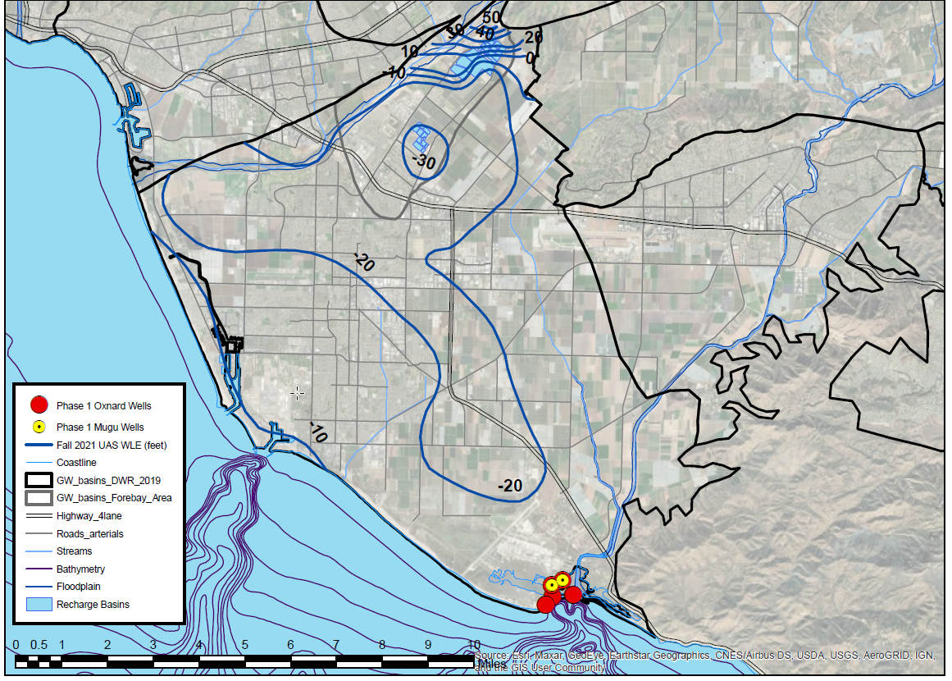
Fall 2021 groundwater elevations in the Upper Aquifer System
Onshore gradients in all coastal areas

Slide 4
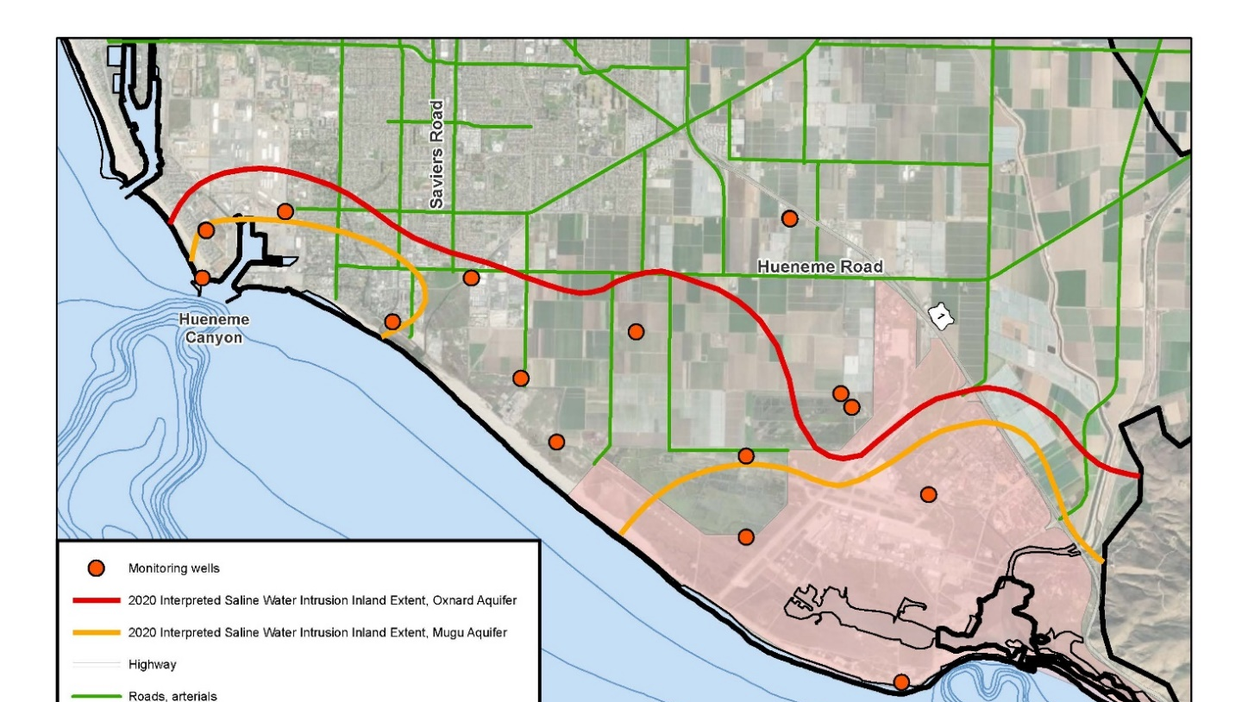
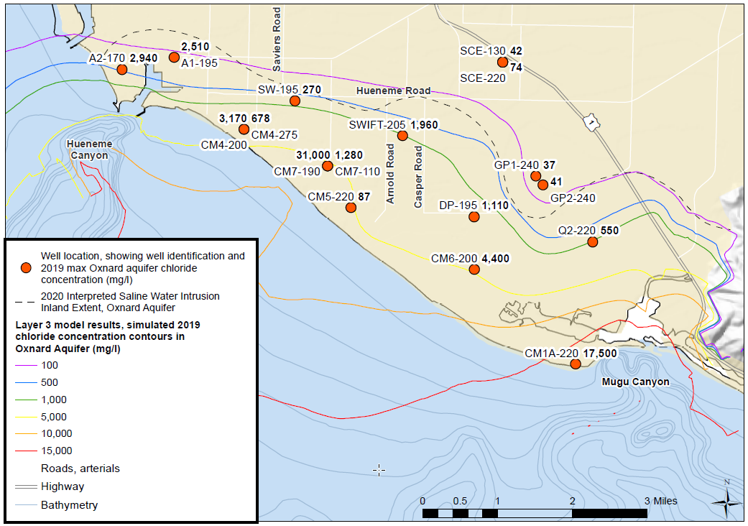
Seawater Intrusion Inland Extent
Seawater intrusion has been a major problem since the 1950s

Slide 5
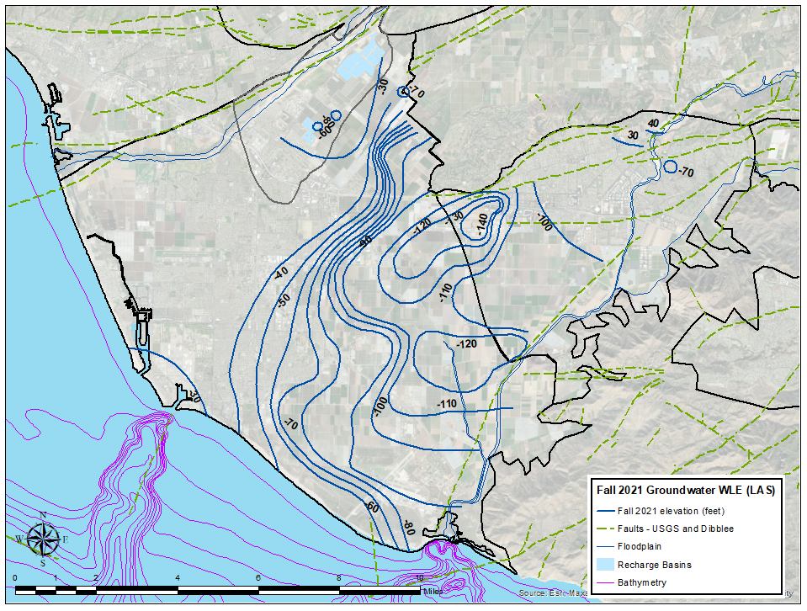
Fall 2021 groundwater elevations in the Upper Aquifer System
Onshore gradients in all coastal areas
Strong vertical gradients from UAS down to LAS
Fall 2021 groundwater elevations in the Lower Aquifer System
Onshore gradients in coastal areas

Slide 6
Extraction Barrier Concept
Hydraulic barrier
Benefits
Groundwater flow towards the coast
Removes saline water from impaired aquifers
No open water intake structures
Coastal well Field
Flow Divide
Seawater Intrusion
Brackish Groundwater
Pumping impacts depicted on this figure are conceptual only, and do not reflect actual measurements or forecasts.

Slide 7
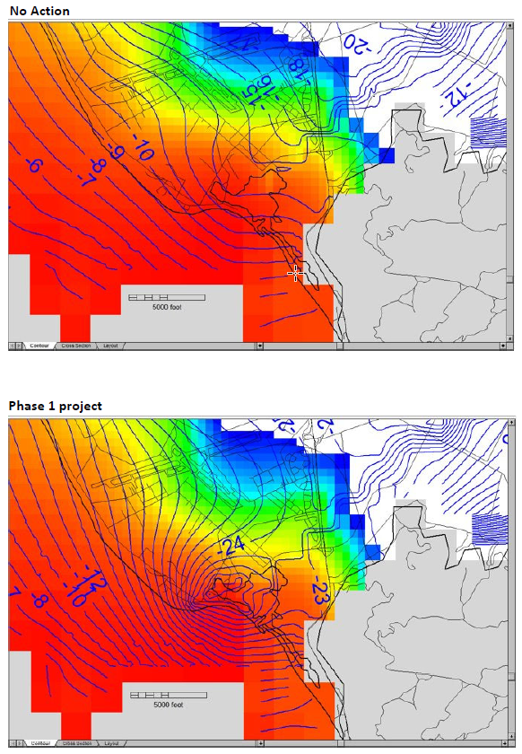
Oxnard Aquifer
2,500 AFY Pumping
No Action Scenario
Onshore flow towards inland areas
Phase 1 EBB Water extraction wells
Influence on coastal groundwater elevations
Simulated chloride concentrations after five years
Five Years of Phase 1 Operation
Groundwater depression at coast creates barrier to seawater intrusion

Slide 8
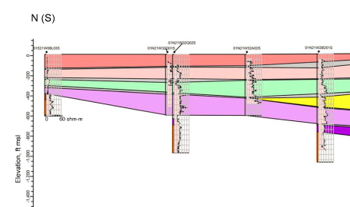
Groundwater Flow with Project
Pumping rates in Oxnard aquifer that controls seawater front and avoids significant vertical flow down from perched aquifer
Design Mugu aquifer pumping rates to balance heads between aquifers and minimize migration of saline water down to deeper aquifers
Legend:
Seawater
Brackish
Perched Water
Fresh Water

Slide 9





Funding and Project Support
Water Board Prop 1 Round 2 Grant Funding (2019-2021)
Groundwater Model Conversion, Calibration and Simulations
Demonstration of Project Effectiveness via Modeling
Regulatory Engagement - TAC Meetings
  State Water Resources Control Board (Water Board)
  LA Regional Water Quality Control Board
  Division of Drinking Water
  Fox Canyon Groundwater Management Agency
  Naval Base Ventura County
Prop 1 Round 3 Implementation Grant proposal submitted July 2022

Slide 10
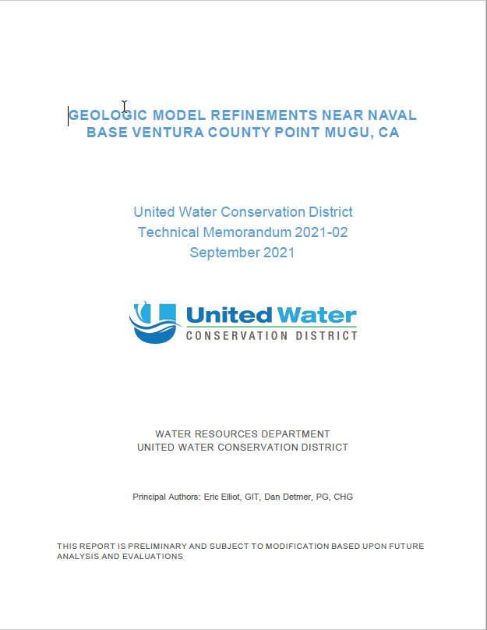
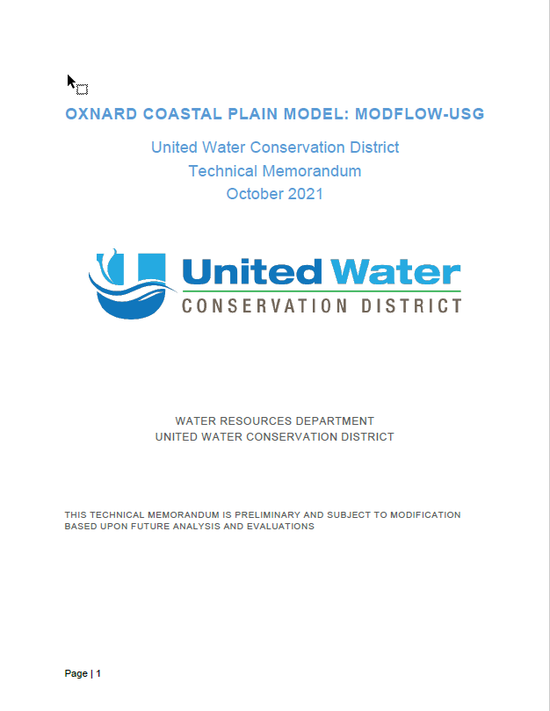
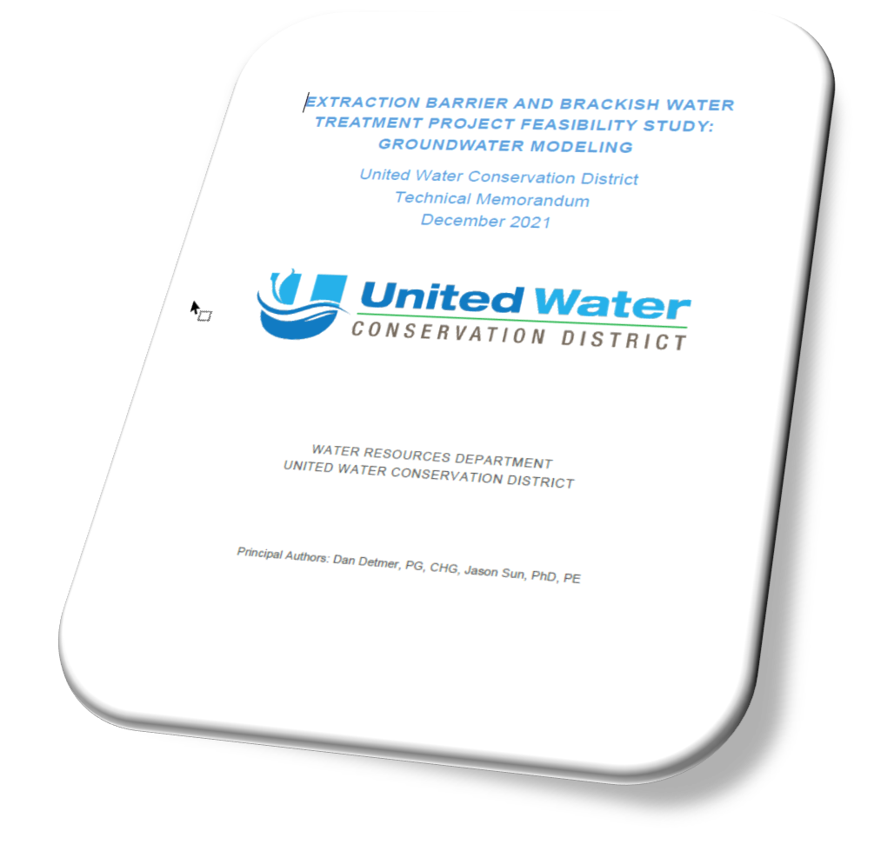
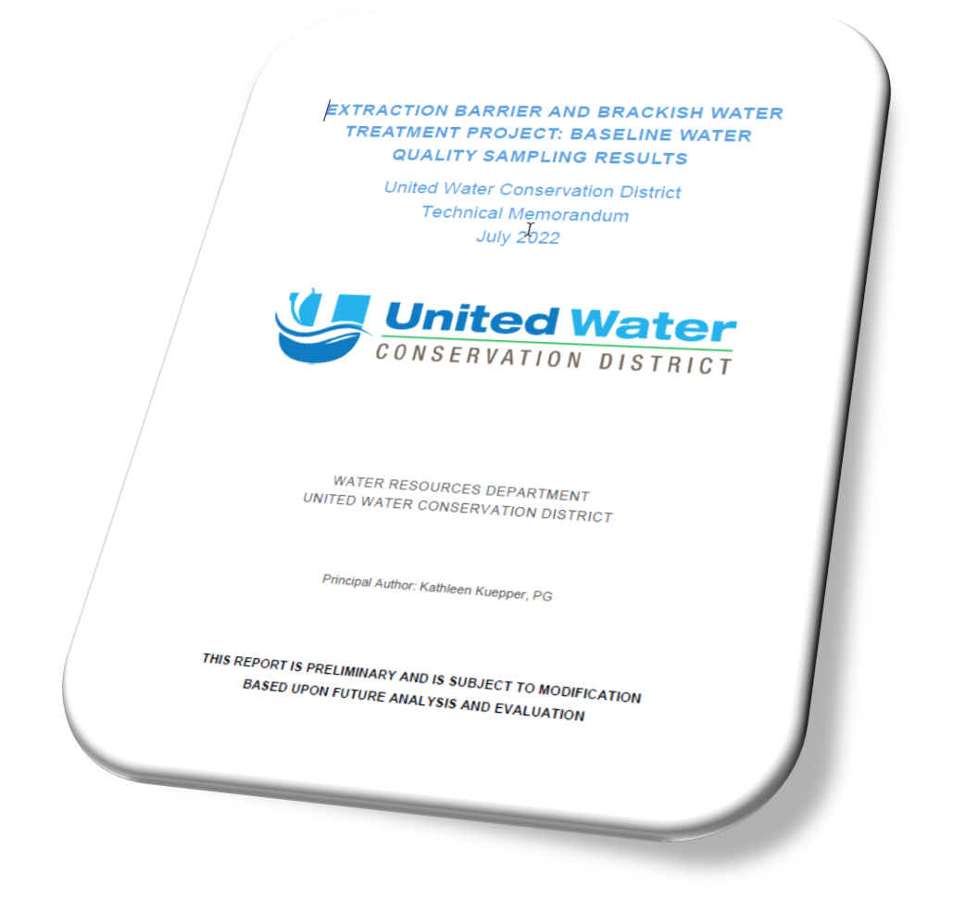
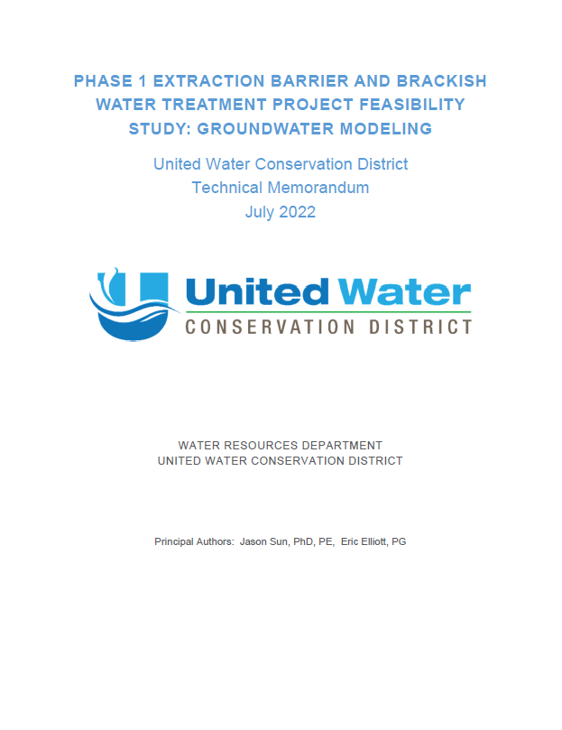
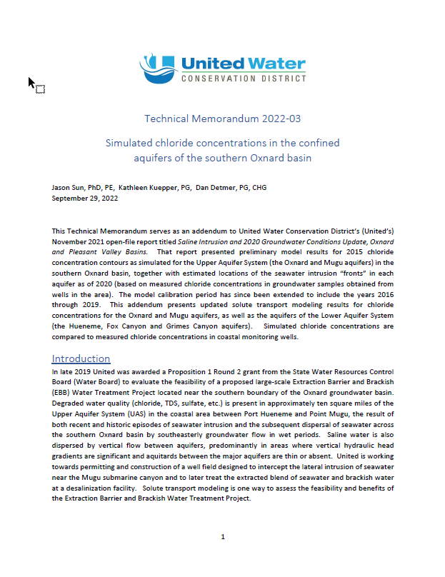
EBB Water Technical Studies Completed
Geologic model refinements in Project area
Solute transport (chloride) modeling with 35-year calibration period added to groundwater flow model
Feasibility study for Project pumping at various scales
Baseline water quality sampling for contaminants
Phase 1 project memo characterizing salt removal from the Oxnard basin
Simulated inland extent of chloride impacts through 2019

Slide 11
Project Planning Update
Phase 1A
(Exploration Phase)
Phase 1B (Implementation Phase)
Monitoring Wells (2022 DWR SGM Grant)
Extraction Wells, Pipelines, and Point of Groundwater Discharge (2022 SWRCB Prop 1 Round 3 Implementation Grant – award pending)
Phase 2
(Build-out Phase)
Expanded extraction well field and monitoring wells
Water treatment and brine disposal
Treated water distribution on base (MOU) and Oxnard Plain
Feasibility Study (2019 SWRCB Prop 1 Round 2 Planning Grant)
Design, CEQA, Permits
Fieldwork

Slide 12
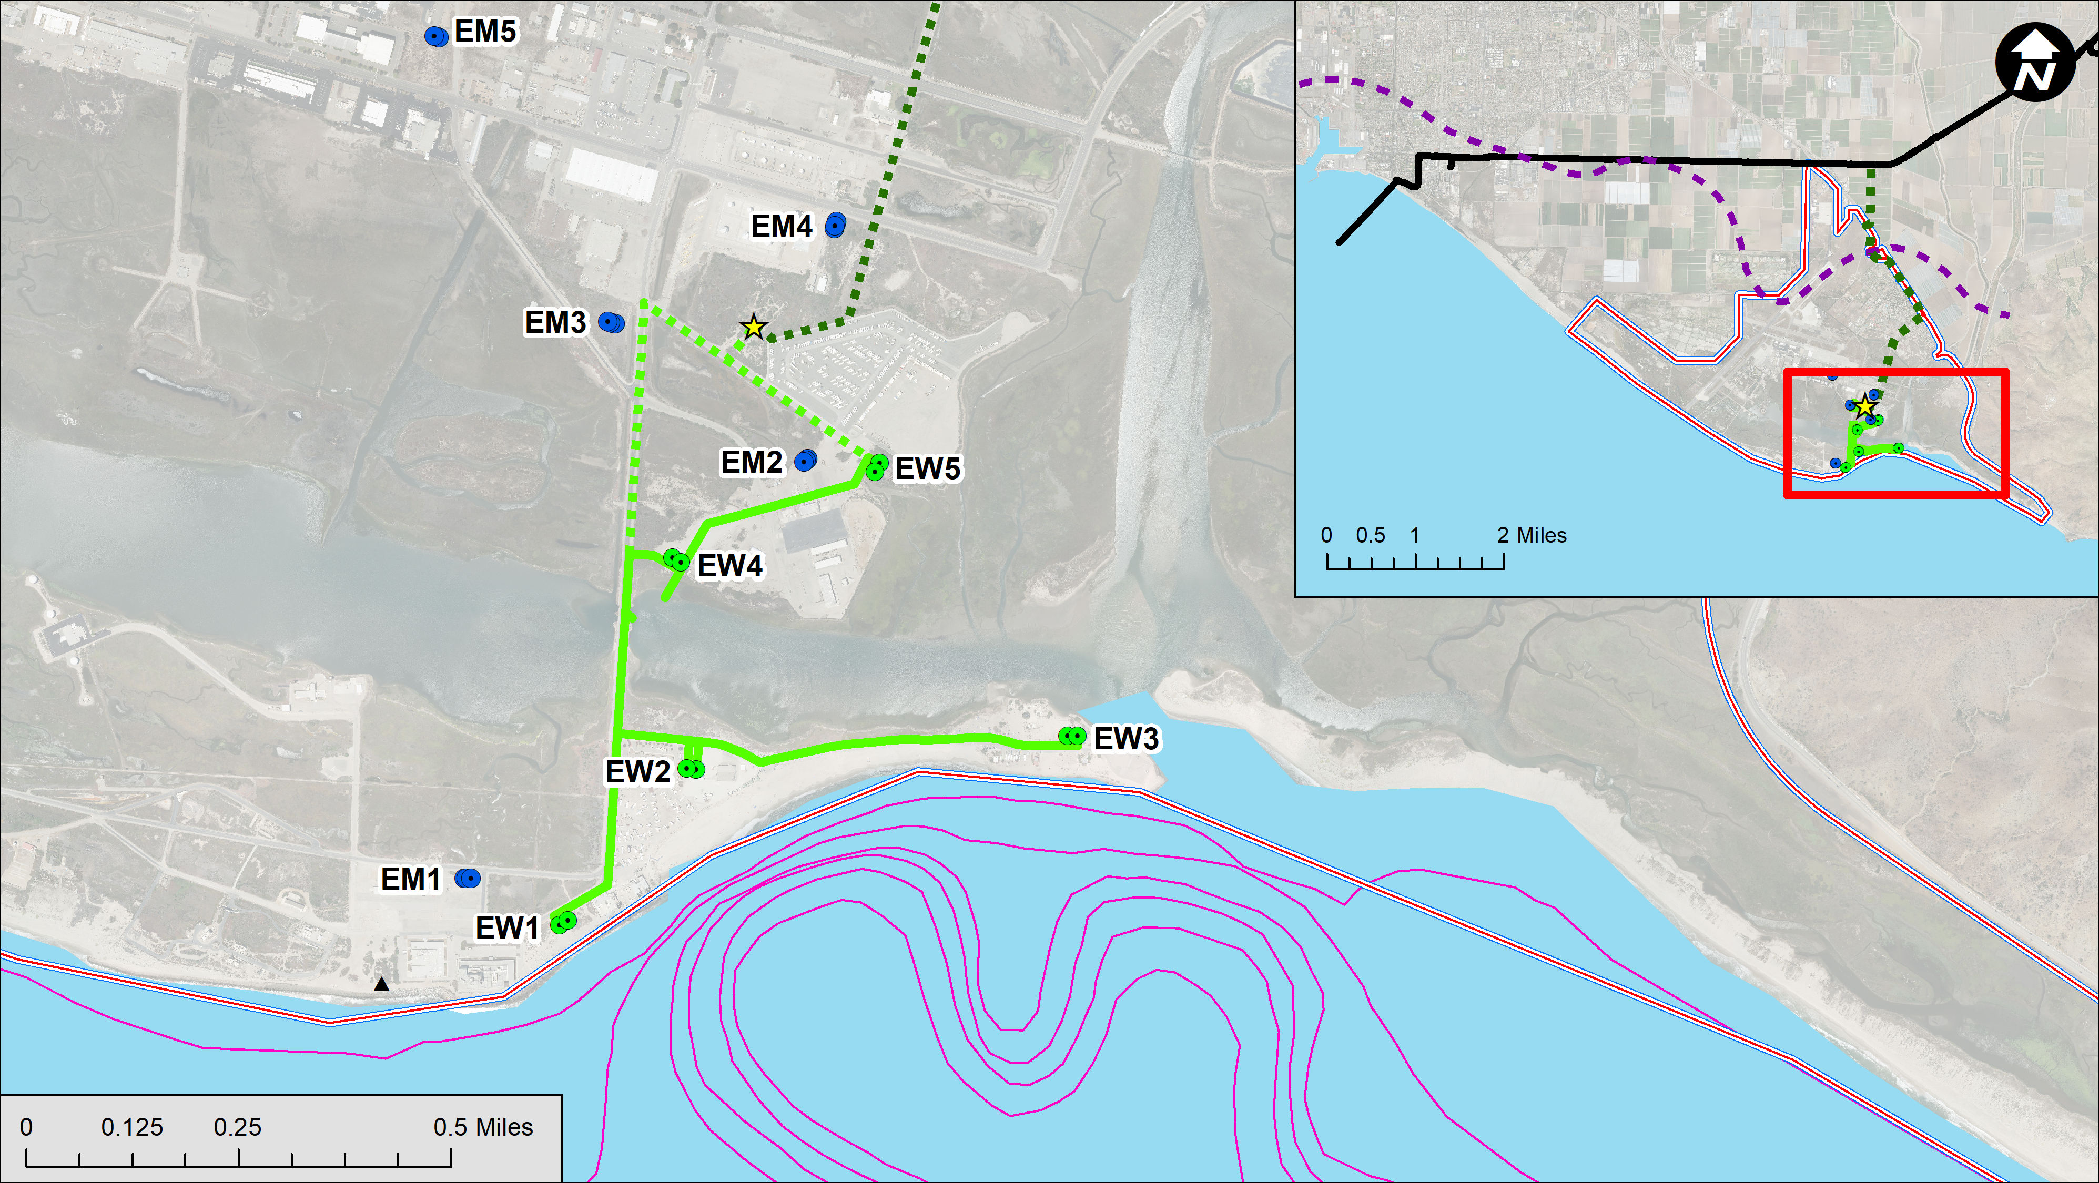
Salinity Management Pipeline
Implementation Phase 1 Scope
5 Monitoring Well Clusters
7 Groundwater Extraction Well and Piping
Final Discharge Location for Extracted Water
Notes:
Exploration and Development Phase
Field Exploration Activities
District’s Right-of-Access through License Agreement 1A (2022-2025)
Discharge Alternatives Evaluation
Implementation Phase
7 Groundwater Extraction Wells and Pipeline
5 Monitoring Well Clusters
Final Discharge Location for Extracted Water

Slide 13
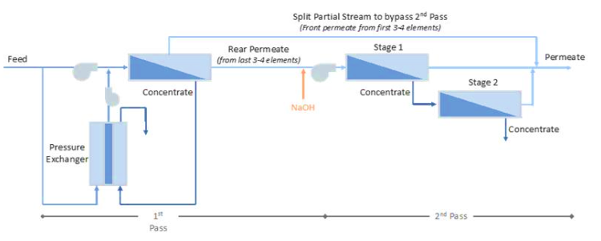
Extended Desktop Modeling
(Trussell Tech, 2022)
Split Partial Stream to bypass 2nd Pass
(Front permeate from first 3-4 elements
Rear Permeate
(from last 3-4 elements
Stage 1
Feed
Permeate
Stage 2
Concentrate
Concentrate
NAOH
Concentrate
Pressure Exchanger
1st Pass
2nd Pass
Notes:
Based on the GW Sampling, we developed …
We did not see any contaminants naturally occurring salt related – no surprises

Slide 14
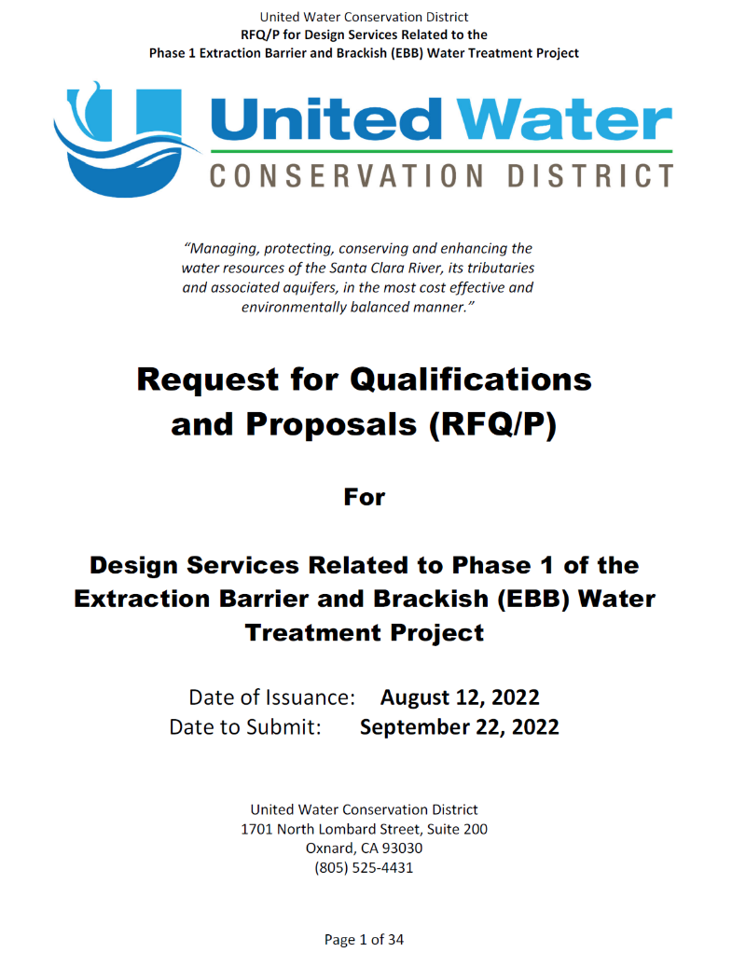
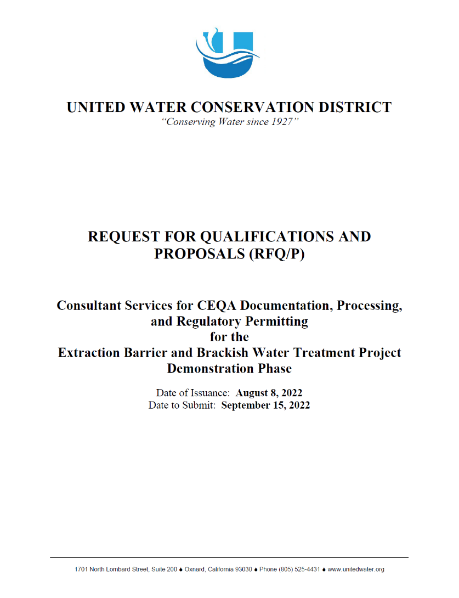
Phase 1 Project
Requests for Qualifications/ Proposals:
CEQA and Permitting Services
  Released on Aug 8
  5 proposals received on Sept 15
Design Services
  Released on Aug 12
  1 proposal received on Sept 22

Slide 15










Regulatory Engagement
Currently Engaged:
Future Engagements:
Division of Drinking Water

Slide 16
Project Timeline
License Agreement
Monitoring Well Construction and Groundwater Sampling
Project Phase | 2022 | 2023 | 2024 | 2025 | 2026 | 2027+
Phase 1A Exploration Phase
Phase 1B Implementation Phase
Phase 2 Build-out Phase
M.O.U.
Extraction Barrier Wells, Pipelines,
Point of Discharge
Construction
Outgrant Easement
Design, CEQA, NEPA, Permits
Design, CEQA, NEPA, Permits
Expanded Well Field,
Treatment, Brine Disposal and Distribution Construction
9/30/2023*
12/31/2025*
* Per 2022 SWRCB Prop 1 GWGP Implementation Grant Schedule

Slide 17
Project Benefits
CONTROL seawater intrusion with an extraction barrier
RESTORE offshore groundwater gradients in coastal areas
REMOVE saline and brackish water from the Oxnard basin
SUPPORT and increase sustainable yield of the OPV basins
MITIGATING the need for significant groundwater extraction reduction
ENHANCEMENT resilience of the local water supply
ENABLING NBVC to meet its water security goals

Slide 18
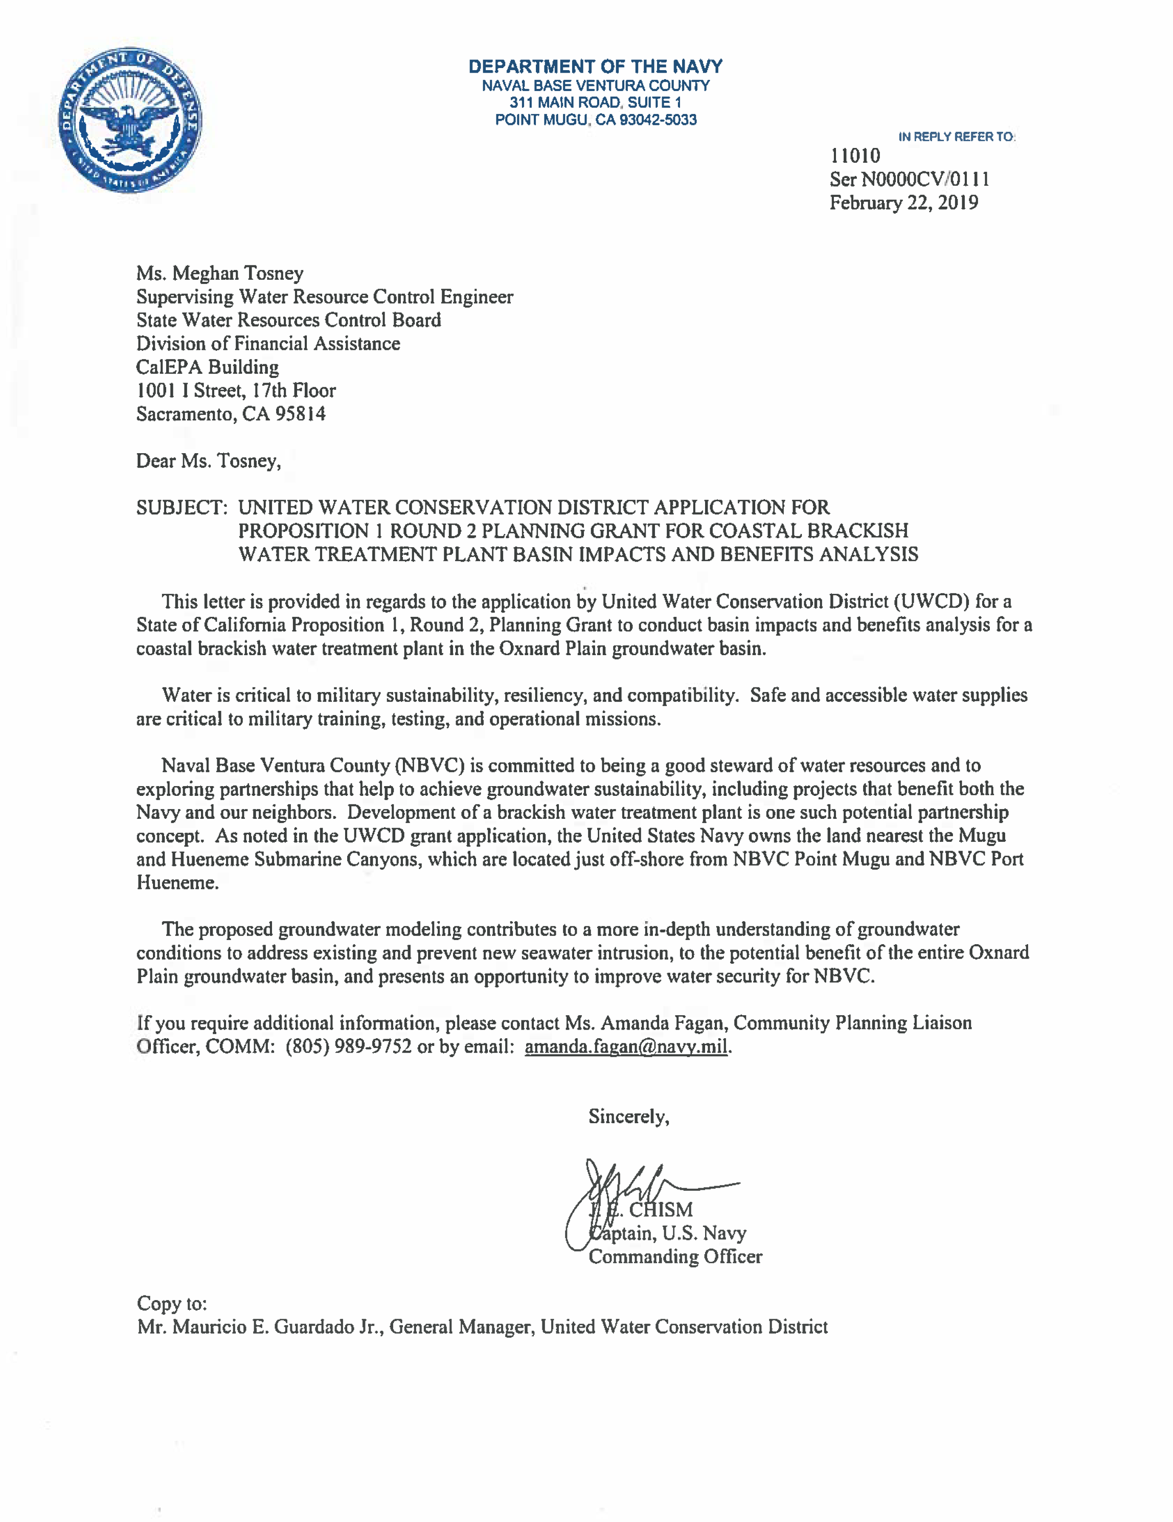
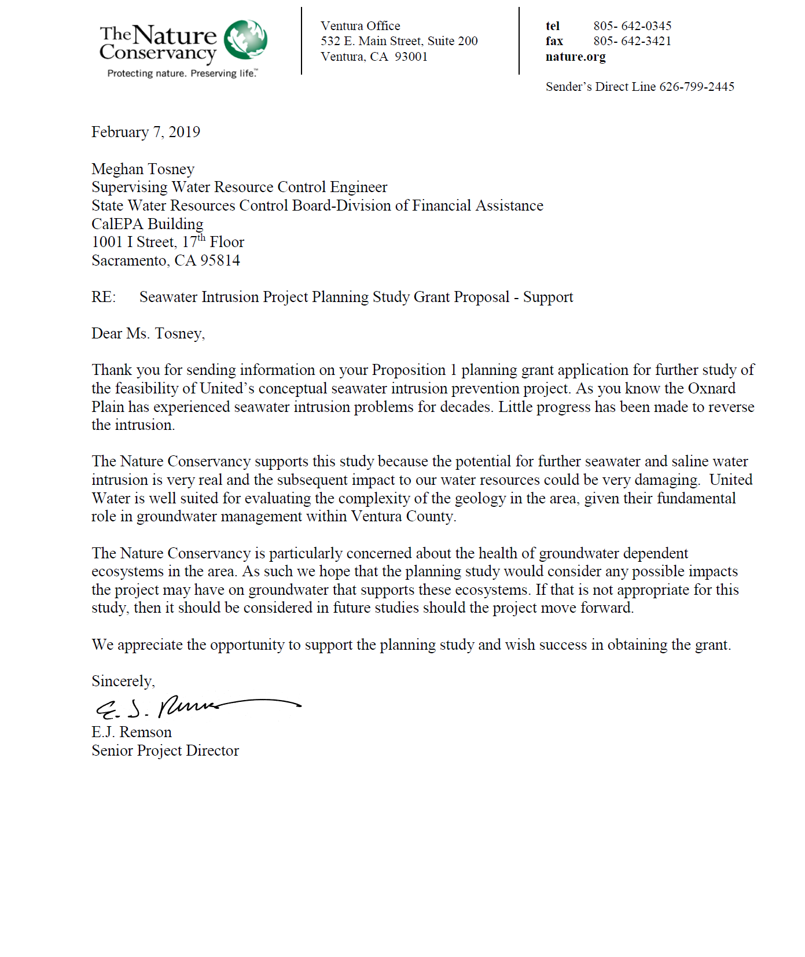
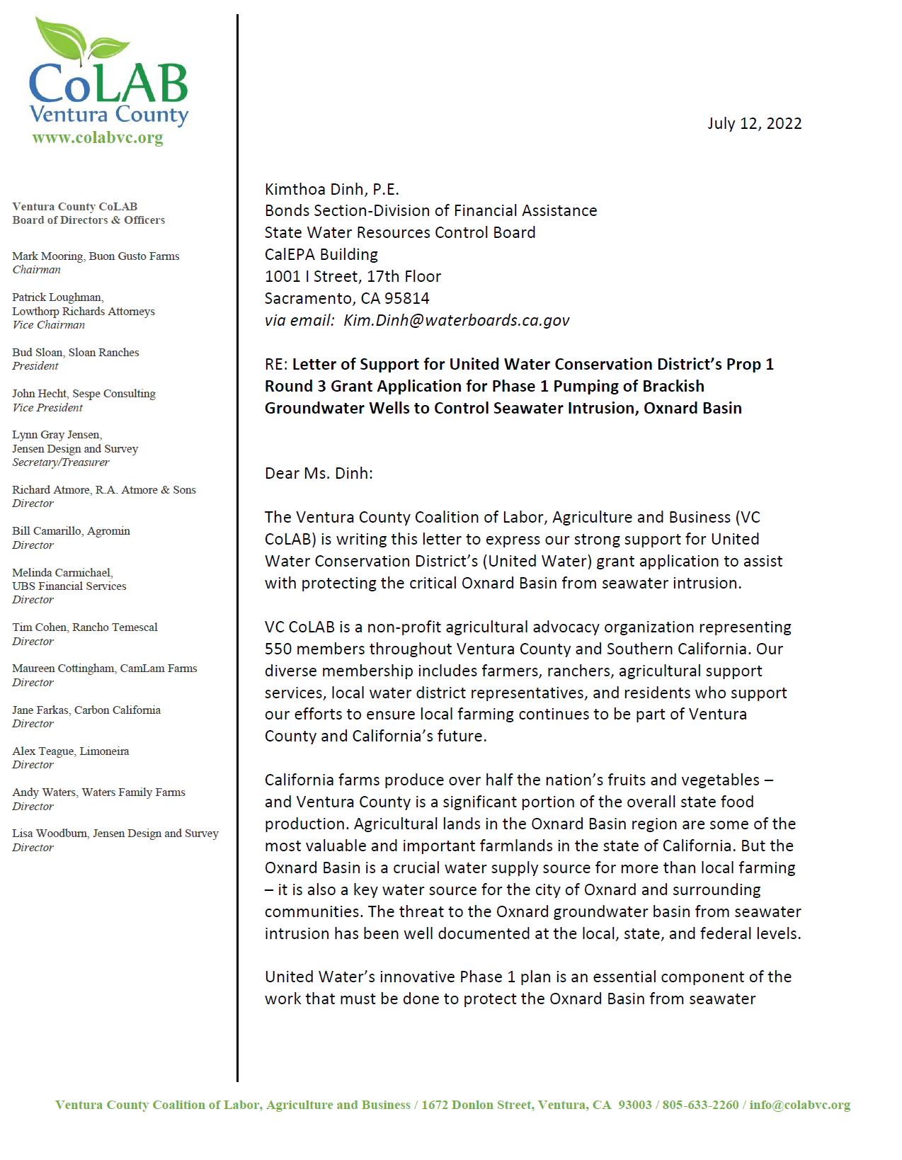
Letters of Support

Slide 19
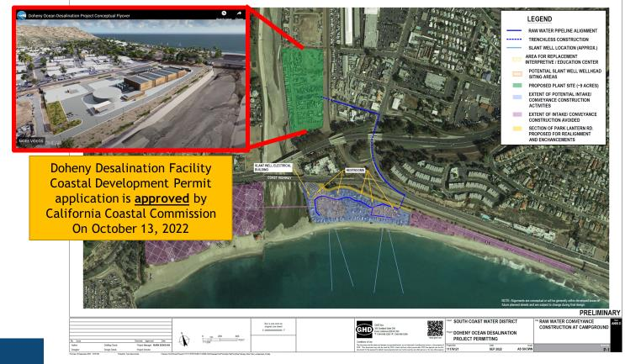
Doheny Ocean Desalination Project

